Slide 1

50.051 Programming Language Concepts W9-S3 Top-Down Parsing
Matthieu De Mari

Slide 2
The unspoken problem #2
Given a CFG and a string x whose syntax needs to be verified
We understand how to use production rules and apply them manually to eventually find the string x.
We understand how to derive a parse tree for the derivation.
We understand how to add syntax-directed rules to our production rules and use them in the derivation.
We understand how to use syntax-directed rules to transform our parse tree into an AST.
We understand that the AST will give us the machine code translation, or at least something already close to what the CPU would need to execute to obtain the outcome of our source code.

Slide 3
The unspoken problem
For syntax analysis, we will now need
An algorithm to find if a given sequence of tokens x has a valid syntax and admits a valid derivation for our given CFG,
(Also known as the parsing problem).
Small tiny teeny issue: This is absolutely not an easy problem algorithmically speaking! (It is very much NP-Hard!) Will take us the next three lectures…! And we will not even dare to implement said algorithms…!

Slide 4
Different types of Parsing
Two big families of parsing algorithms
Top-Down Parsing
To be discussed in W9S3, and maybe W11S1.
Most intuitive approach.
Begin with the start symbol, try to guess the production rules to apply and end up with the stream of symbols you want.
Bottom-Up Parsing
Something for later (W11S1-2?).

Slide 5
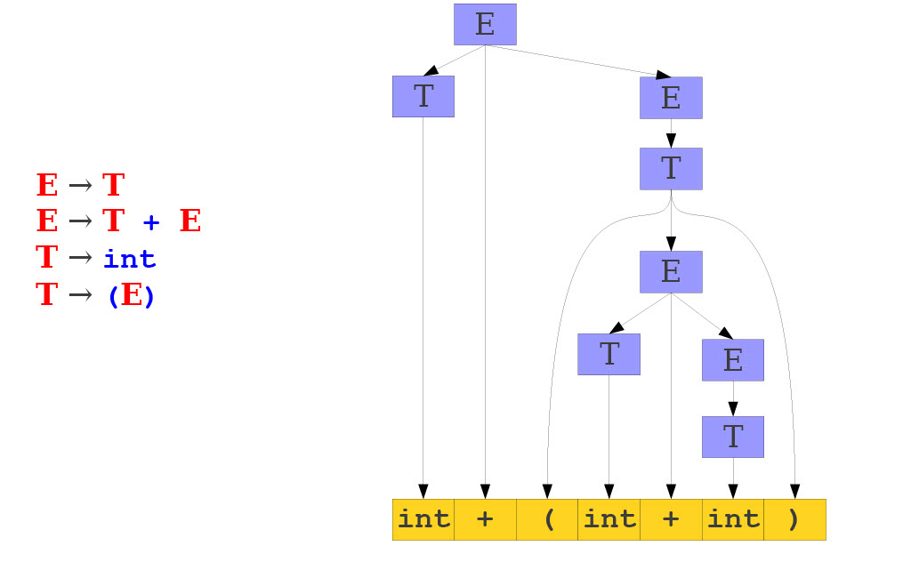
Top-Down Parsing

Slide 6
Challenges in Top-Down Parsing
Top-down parsing begins with virtually no information.
Begins with just the start symbol, which matches every program.
How can we know which productions to apply?
In general, we cannot.

Slide 7
Conclusion
Good luck for the exam!

Slide 8
Challenges in Top-Down Parsing
Top-down parsing begins with virtually no information.
Begins with just the start symbol, which matches every program.
How can we know which productions to apply?
In general, we cannot.
There are some grammars for which the best we can do is guess and backtrack if we are wrong.
If we have to guess, how do we do it?

Slide 9
Top-Down as a Graph Search
First idea: treat parsing as a graph search.
Each node is a sentential form (a string of terminals and non-terminals symbols derivable from the start symbol).
There is an edge from node α to node β iff α can be transformed into β using a production rule from the CFG.
Objective: Find if the graph of all possible applications of the CFG rules eventually admits a node whose sentential form corresponds to our string x.

Slide 10
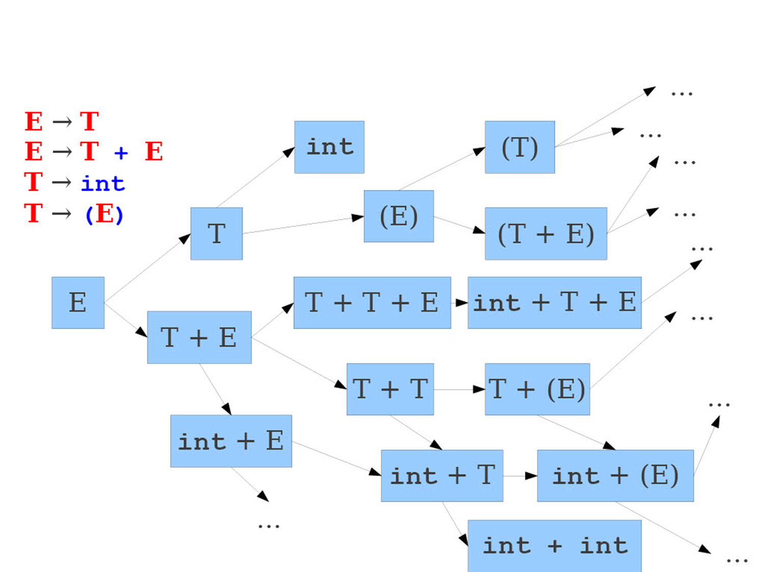
Graph Search Problem

Slide 11
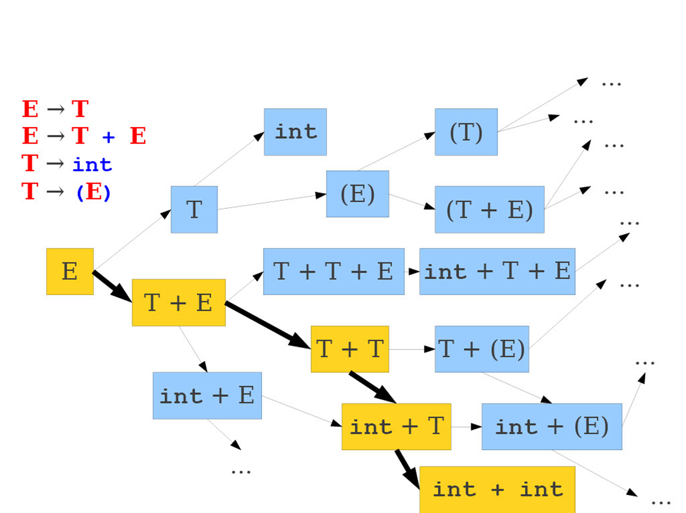
Graph Search Problem

Slide 12
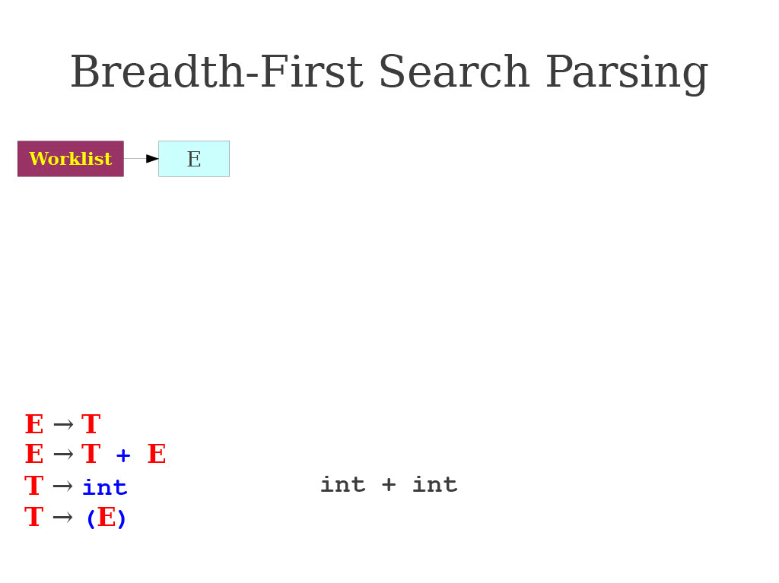
BFS in action: demo on a simple CFG

Slide 13
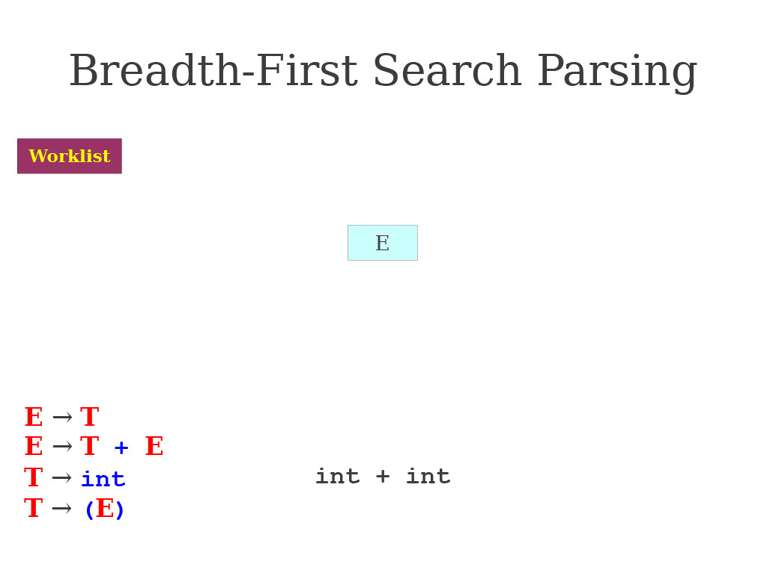
BFS in action: demo on a simple CFG

Slide 14
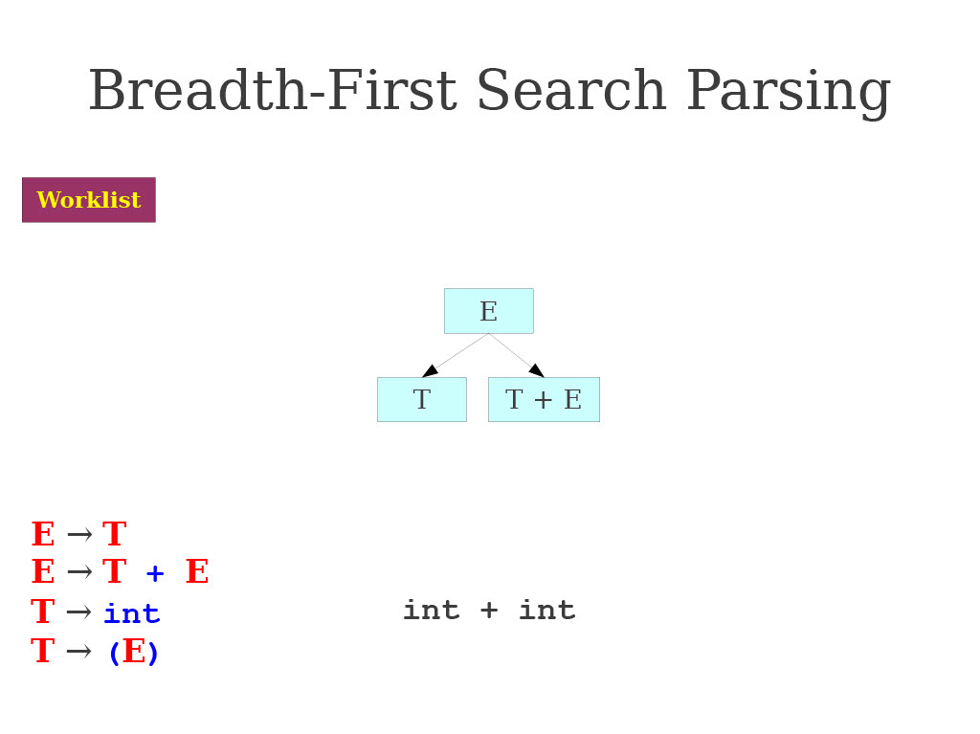
BFS in action: demo on a simple CFG

Slide 15
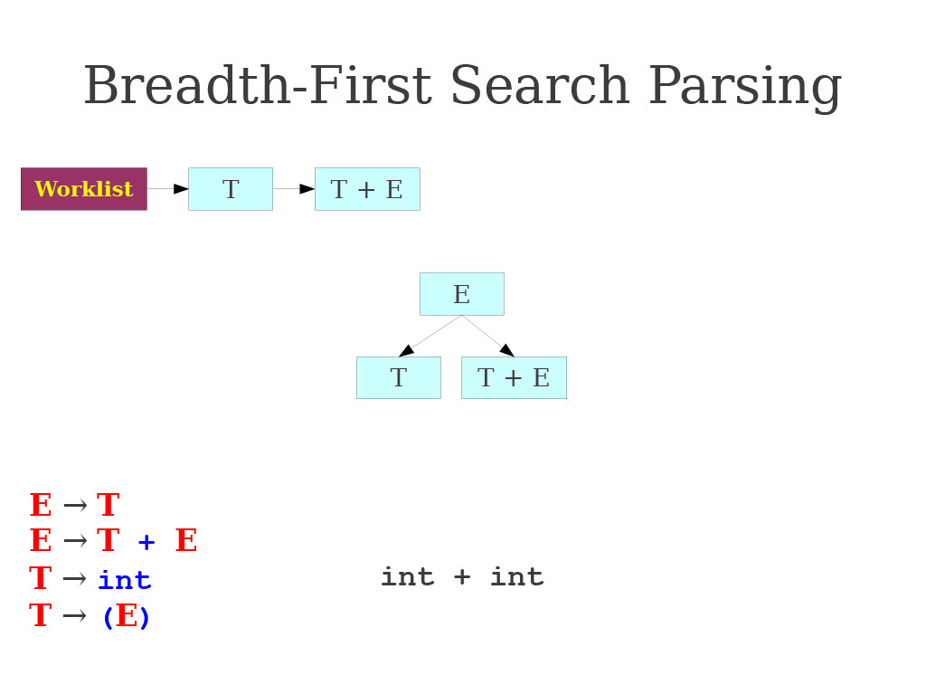
BFS in action: demo on a simple CFG

Slide 16
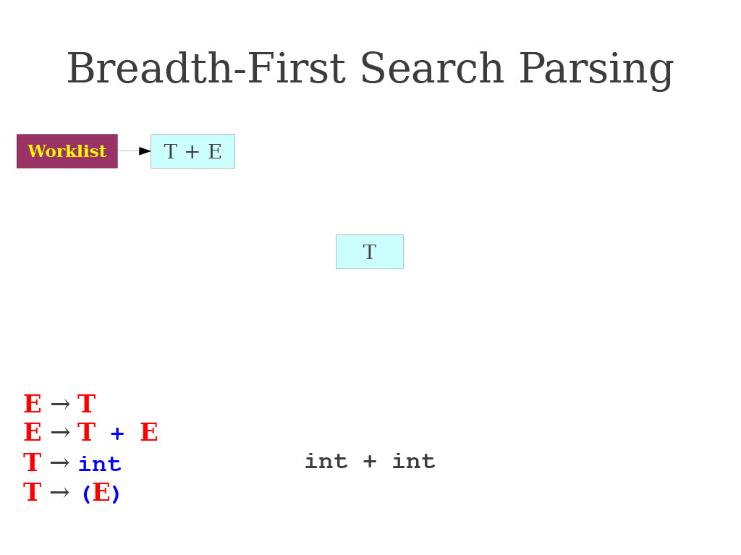
BFS in action: demo on a simple CFG

Slide 17
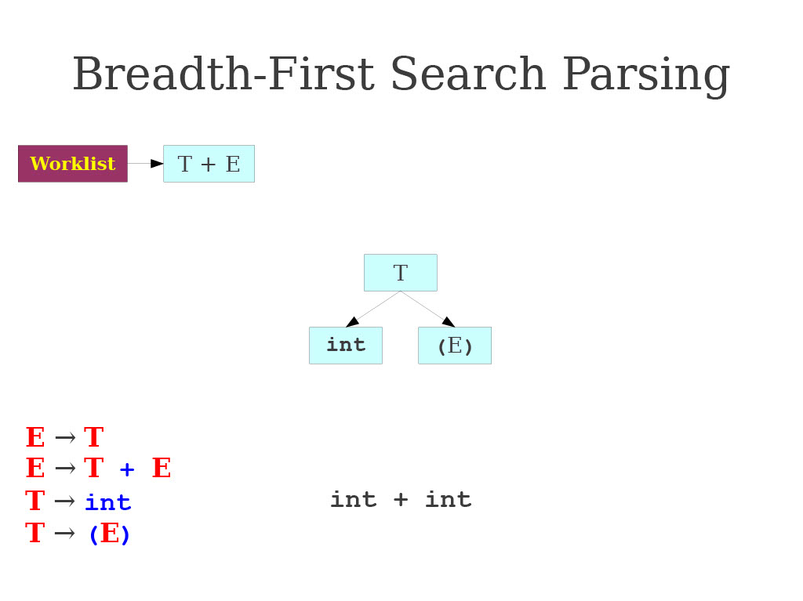
BFS in action: demo on a simple CFG

Slide 18
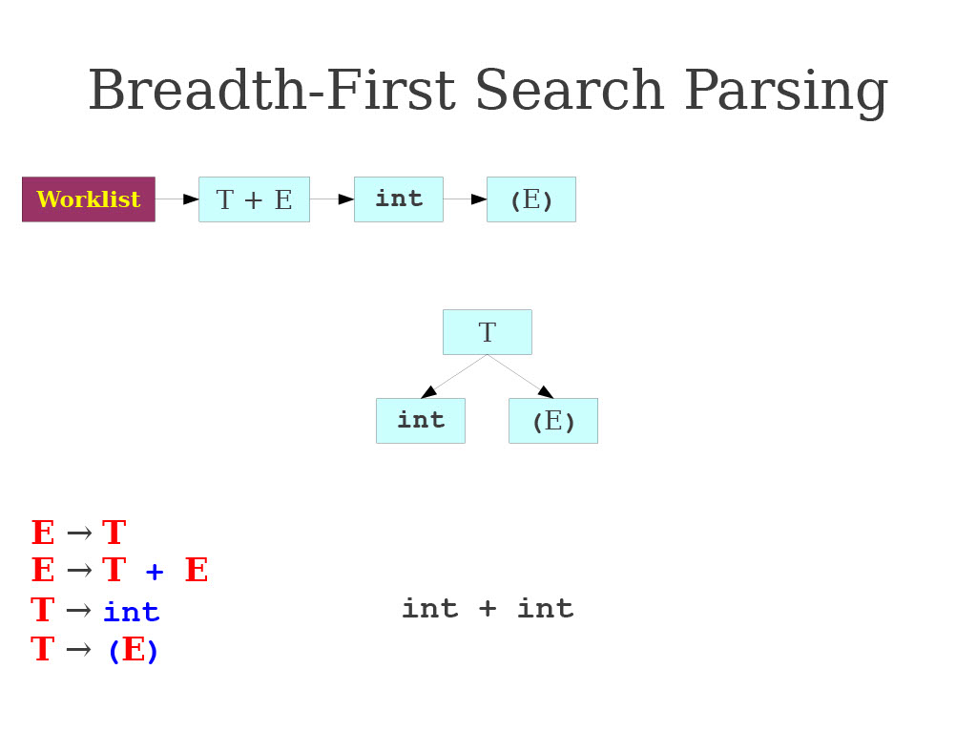
BFS in action: demo on a simple CFG

Slide 19
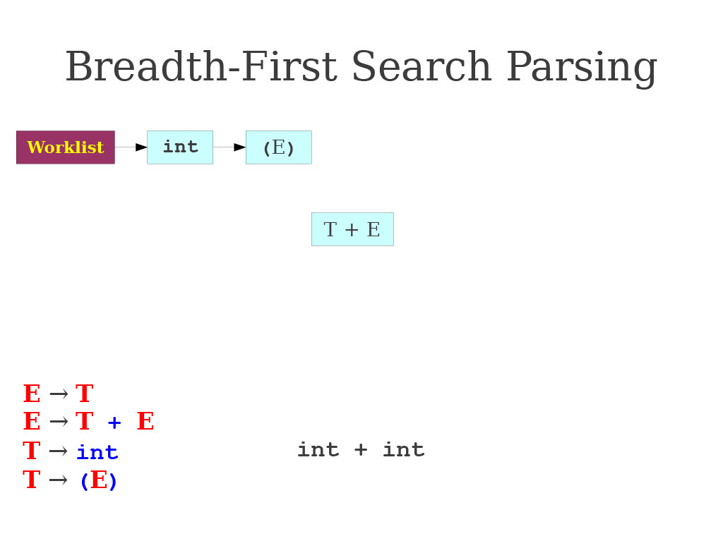
BFS in action: demo on a simple CFG

Slide 20
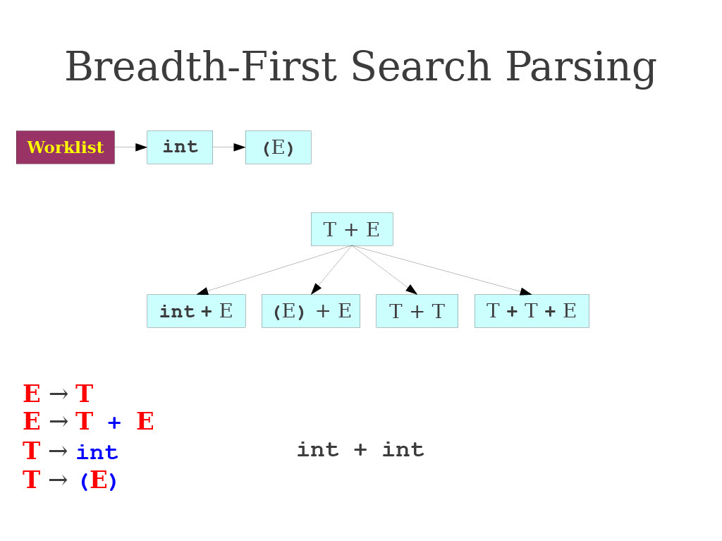
BFS in action: demo on a simple CFG

Slide 21
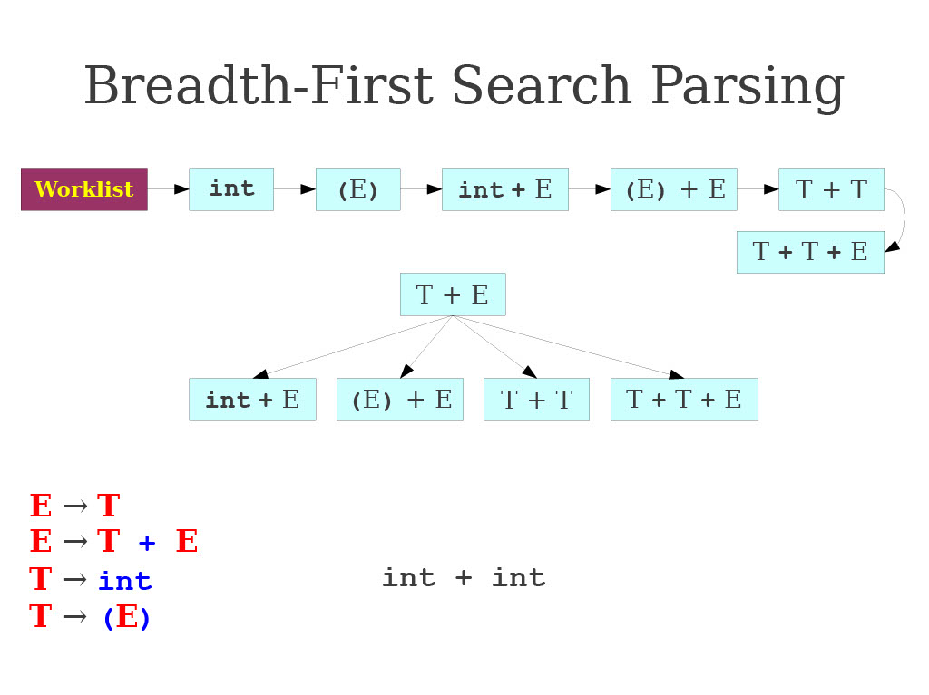
BFS in action: demo on a simple CFG

Slide 22
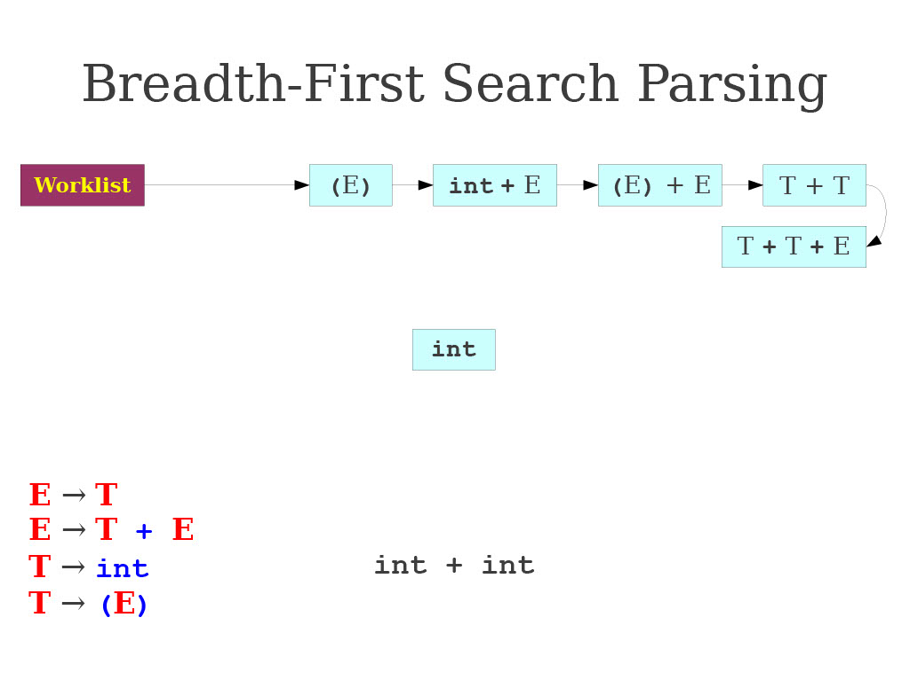
BFS in action: demo on a simple CFG

Slide 23
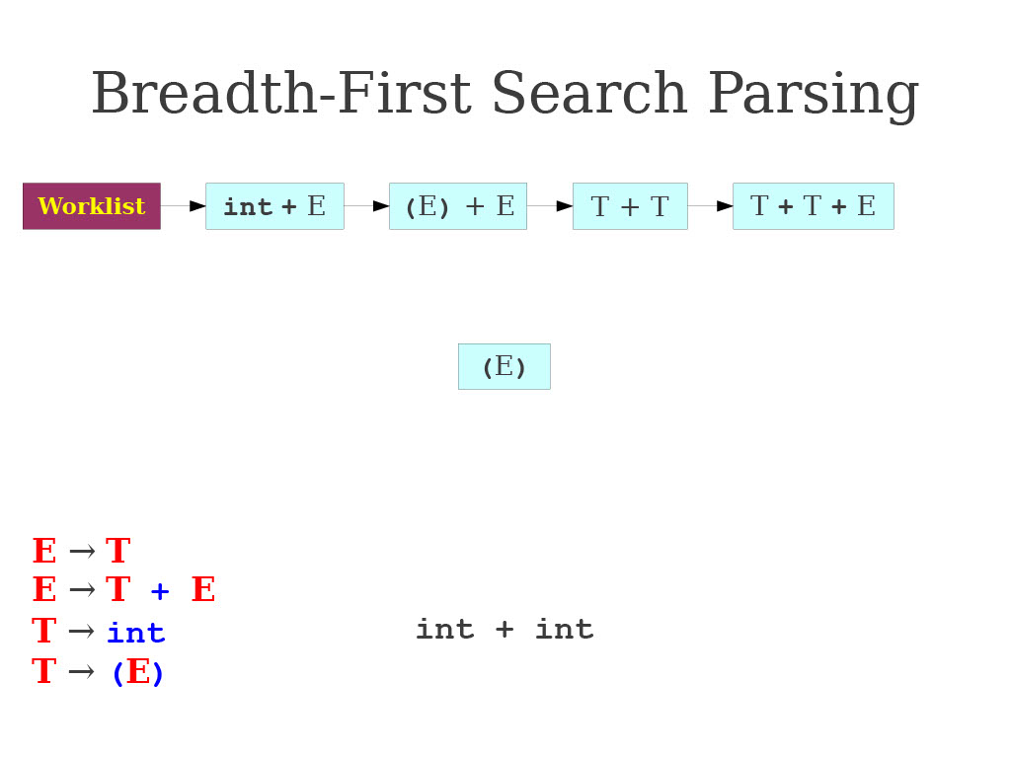
BFS in action: demo on a simple CFG

Slide 24
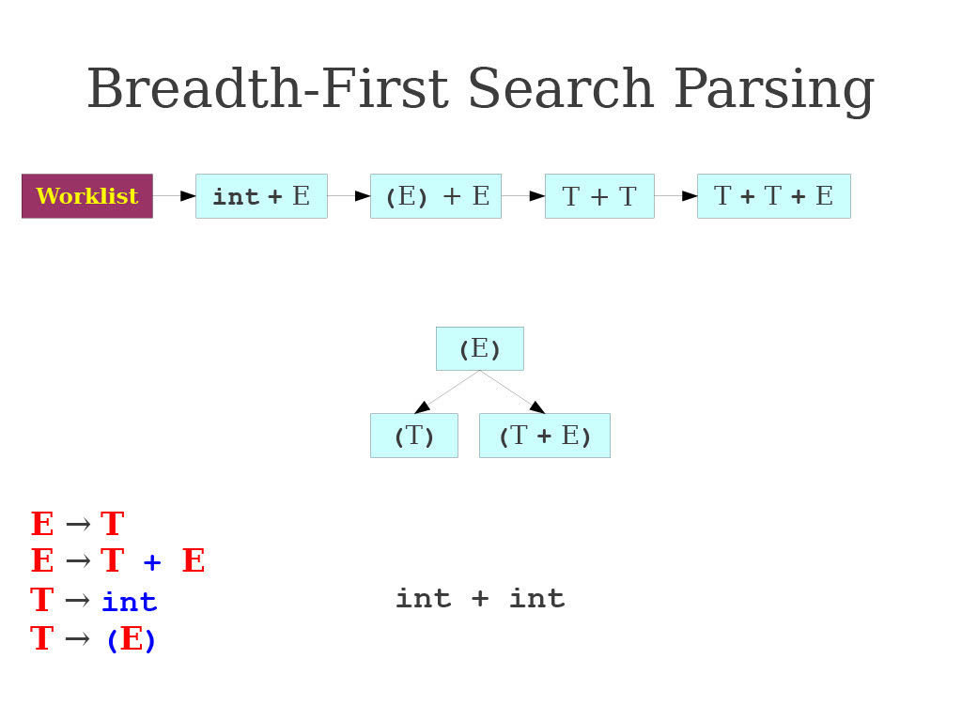
BFS in action: demo on a simple CFG

Slide 25
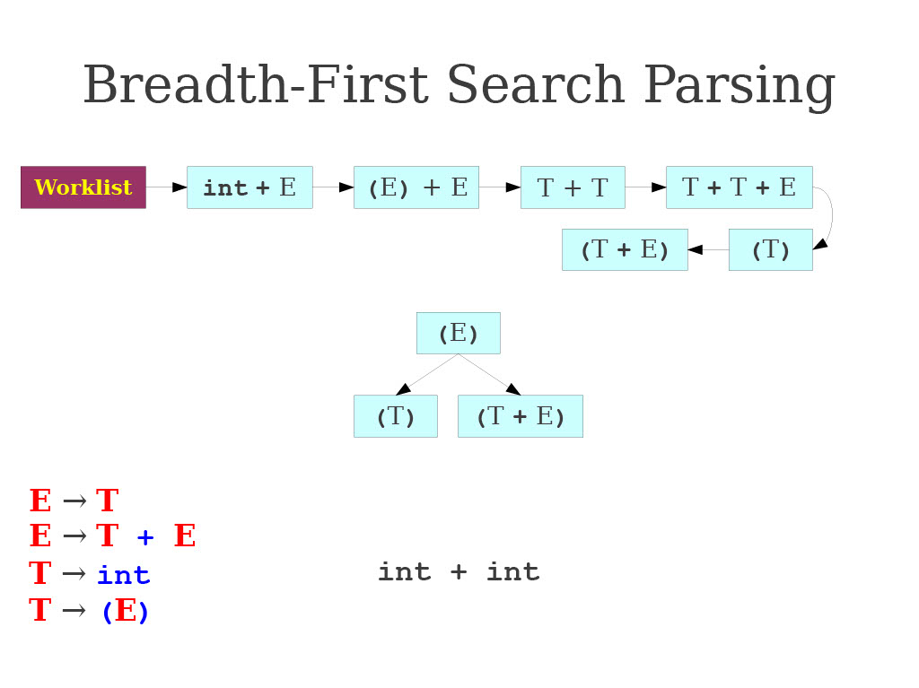
BFS in action: demo on a simple CFG

Slide 26
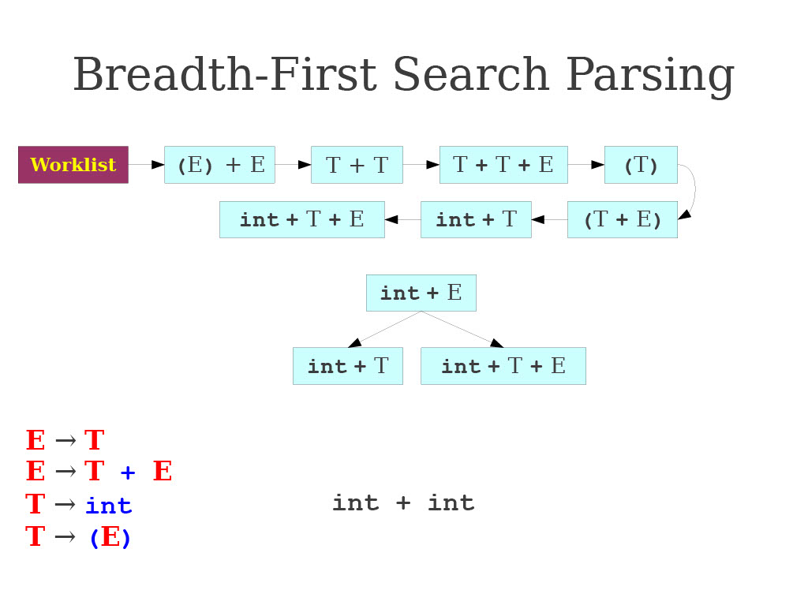
BFS in action: demo on a simple CFG

Slide 27
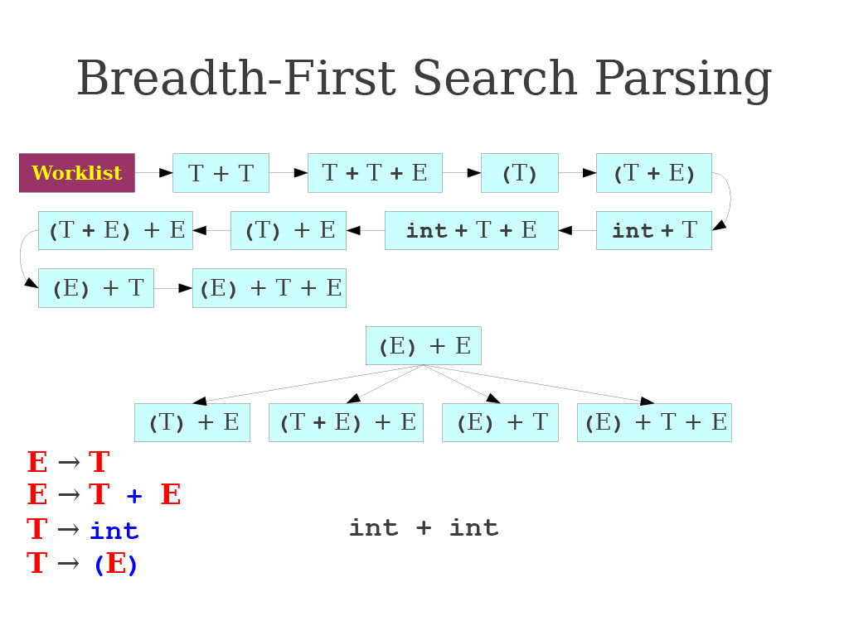
BFS in action: demo on a simple CFG

Slide 28
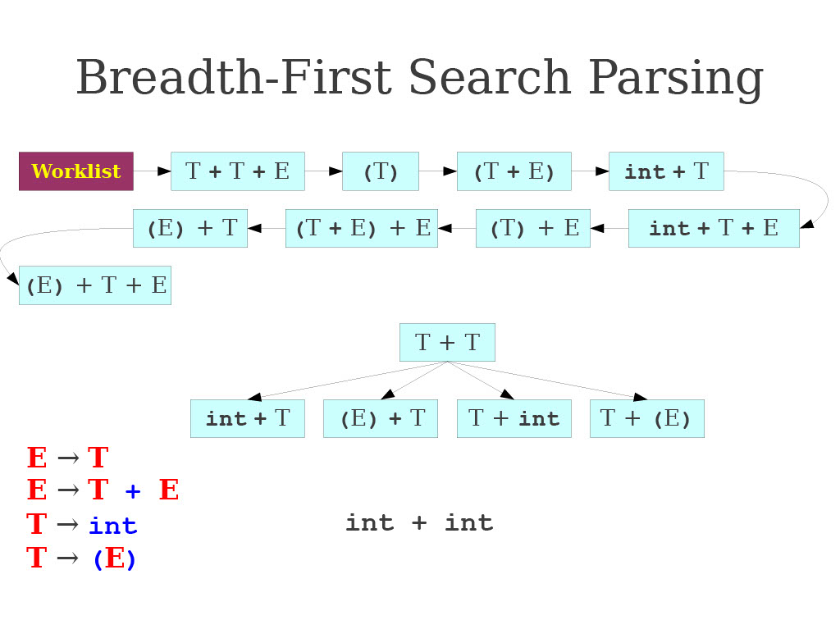
BFS in action: demo on a simple CFG

Slide 29
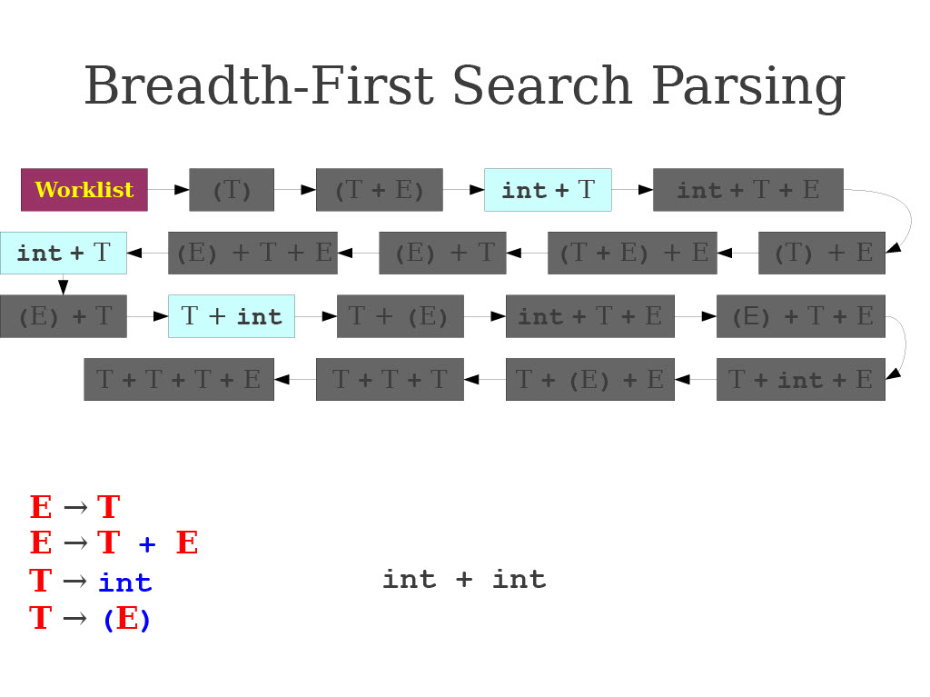
BFS in action: demo on a simple CFG

Slide 30
BFS is slow, but guaranteed to work
Good: Guaranteed to work? But equivalent to “brute-force”?
Problem: time and memory usage due to lots of wasted effort…
BFS generates a lot of sentential forms that could not possibly match.
But in general, it is extremely hard to tell whether a sentential form can match…
That is the job of parsing!
Complexity comes from a high branching factor: Each sentential form can expand in (potentially) many ways for each non-terminal it contains.

Slide 31
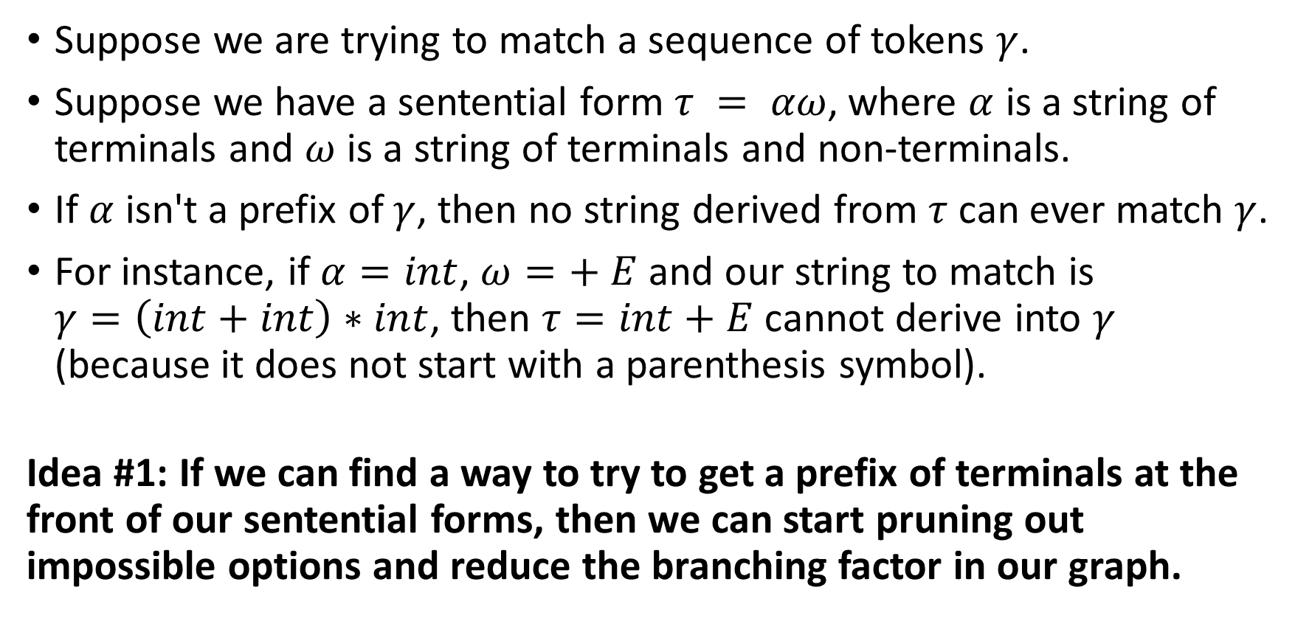
Reducing the branching factor: Idea #1
Suppose we are trying to match a sequence of tokens $γ$.
Suppose we have a sentential form $τ = αω$, where $α$ is a string of terminals and $ω$ is a string of terminals and non-terminals.
If $α$ isn't a prefix of $γ$, then no string derived from $τ$ can ever match $γ$.
For instance, if $α=int$, $ω=+ E$ and our string to match is $γ=\left(int+int\right)∗int$, then $τ=int+E$ cannot derive into $γ$ (because it does not start with a parenthesis symbol).
Idea #1: If we can find a way to try to get a prefix of terminals at the front of our sentential forms, then we can start pruning out impossible options and reduce the branching factor in our graph.

Slide 32
Leftmost derivation
Definition (Leftmost Derivation):
In parsing, a Leftmost Derivation is a derivation where we always try to transform the leftmost non-terminal first.
For instance, consider that the current string is T + E, with T and E being non-terminals. The leftmost derivation will suggest to transform T first, and figure out how to transform E later.
Similarly, we can define a Rightmost Derivation, where we always try to transform the rightmost non-terminal first.

Slide 33
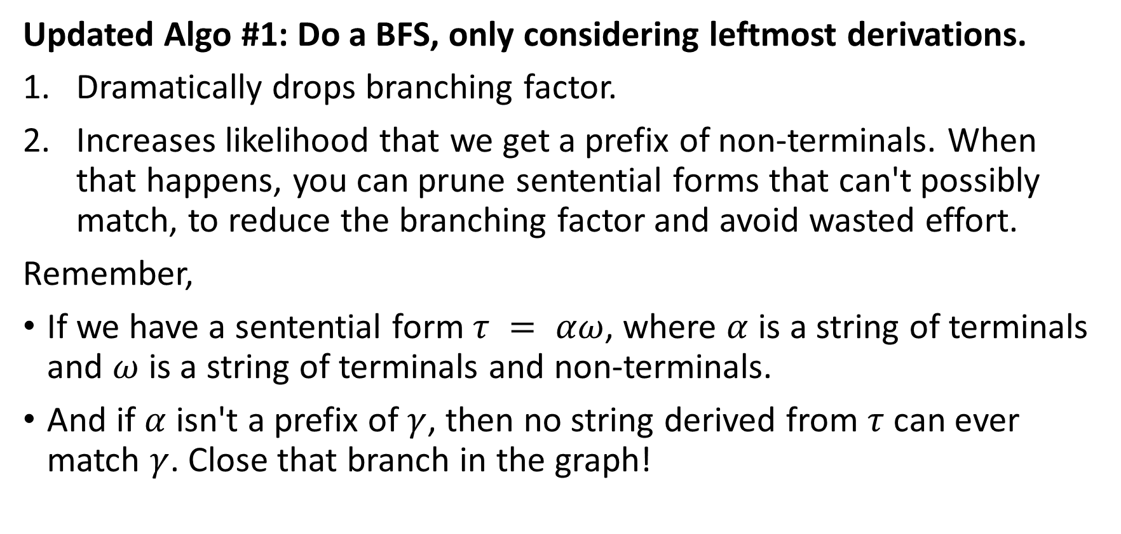
Updated algo: Leftmost BFS
Updated Algo #1: Do a BFS, only considering leftmost derivations.
Dramatically drops branching factor.
Increases likelihood that we get a prefix of non-terminals. When that happens, you can prune sentential forms that can't possibly match, to reduce the branching factor and avoid wasted effort.
Remember,
If we have a sentential form $τ = αω$, where $α$ is a string of terminals and $ω$ is a string of terminals and non-terminals.
And if $α$ isn't a prefix of $γ$, then no string derived from $τ$ can ever match $γ$. Close that branch in the graph!

Slide 34
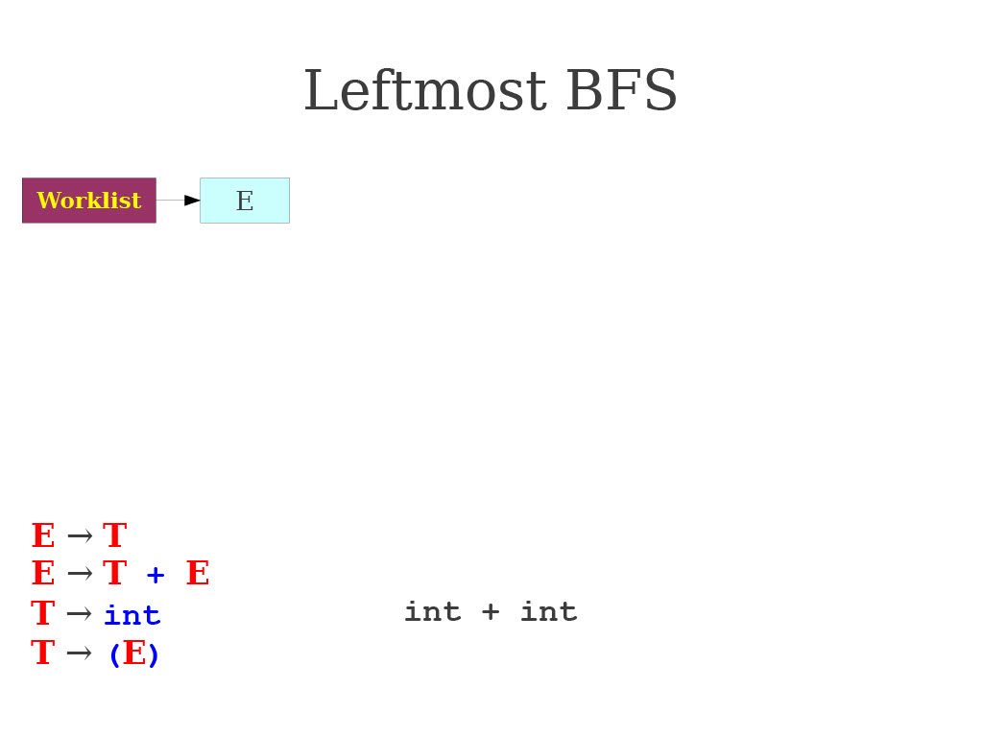
Leftmost BFS in action

Slide 35
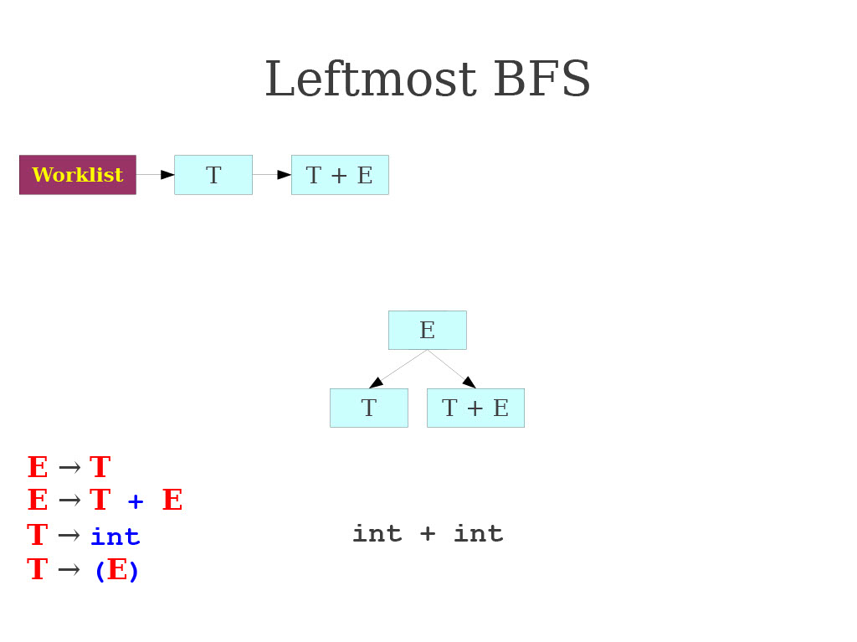
Leftmost BFS in action

Slide 36
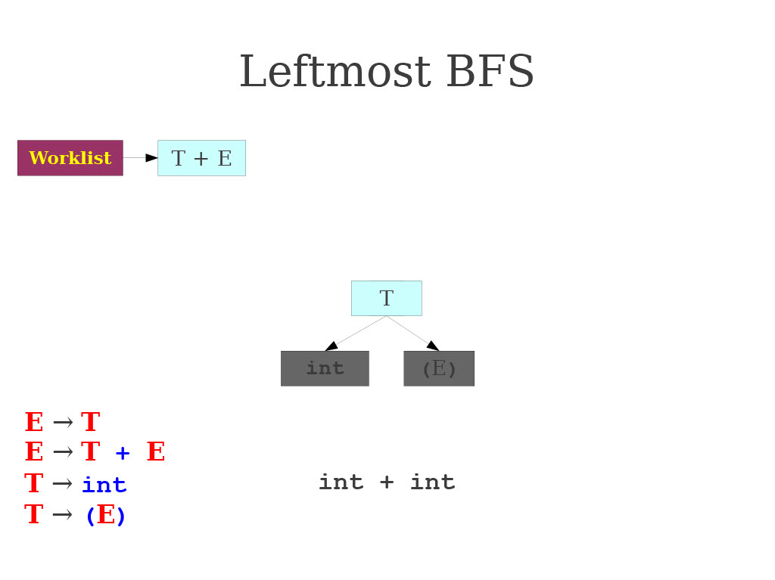
Leftmost BFS in action

Slide 37
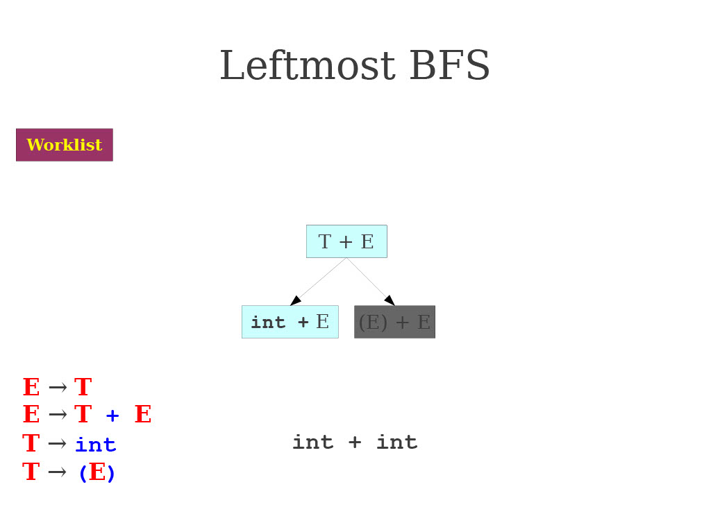
Leftmost BFS in action

Slide 38
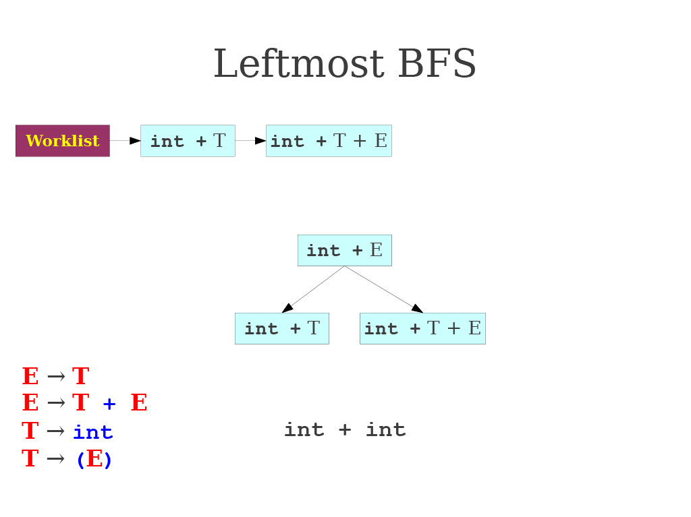
Leftmost BFS in action

Slide 39
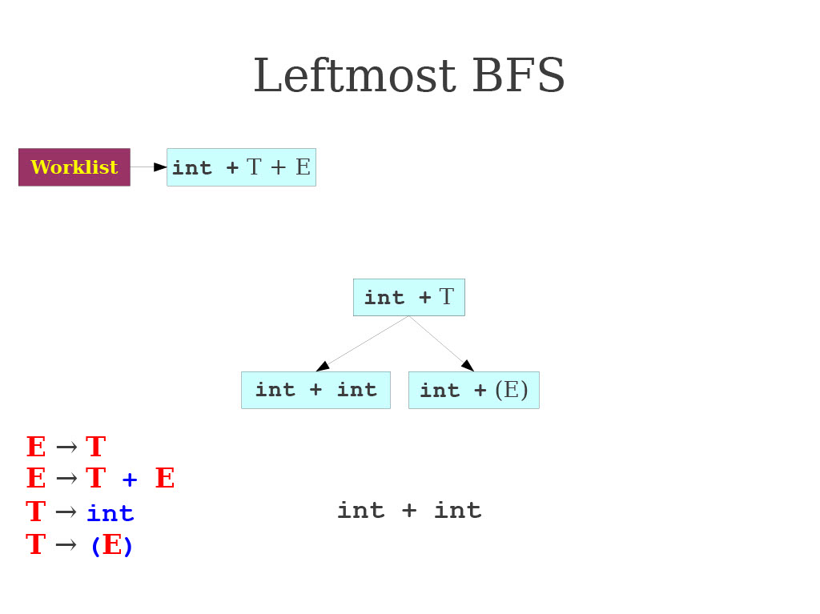
Leftmost BFS in action

Slide 40
Leftmost BFS: improvements and issues
Substantial speed, performance and memory improvement over the naïve BFS algorithm.
Uses the pruning property we established earlier.
Can more rapidly find a valid parse of a program if one exists.
Can easily be modified to find if a program cannot be parsed.
Unfortunately, there are still many problems.

Slide 41
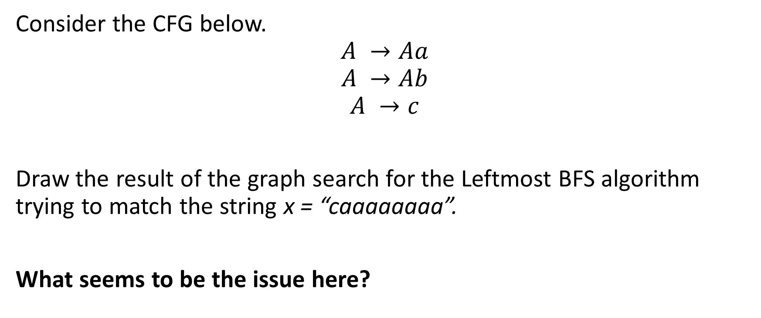
Practice 1: Leftmost BFS problem.
Consider the CFG below.
$$A →Aa$$
$$A →Ab$$
$$A →c$$
Draw the result of the graph search for the Leftmost BFS algorithm trying to match the string x = “caaaaaaaa”.
What seems to be the issue here?

Slide 42
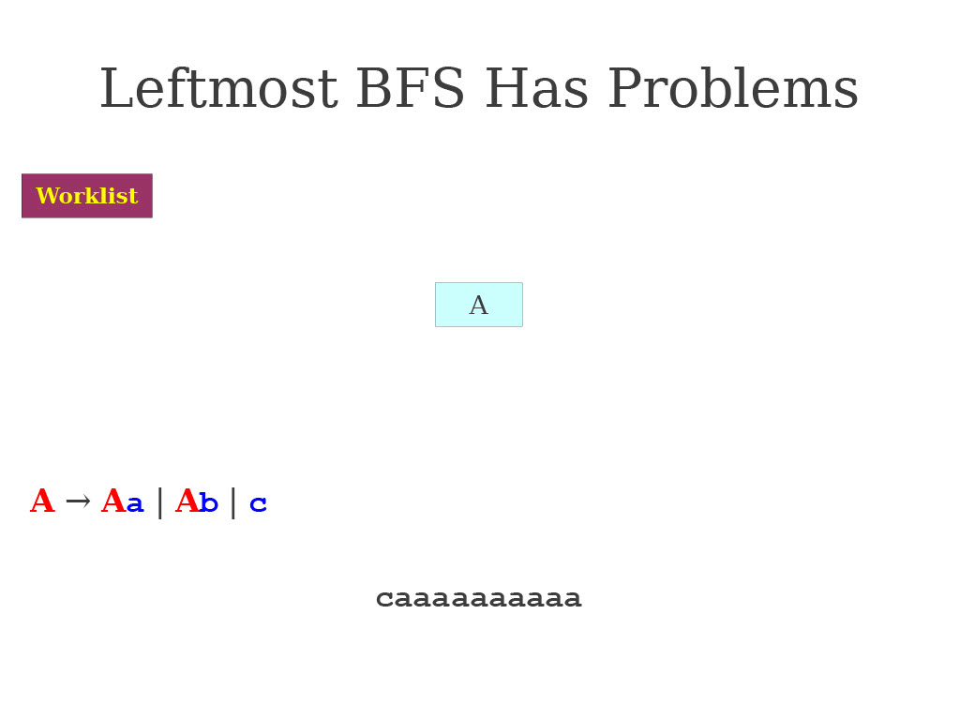
Practice 1: Leftmost BFS problem.

Slide 43
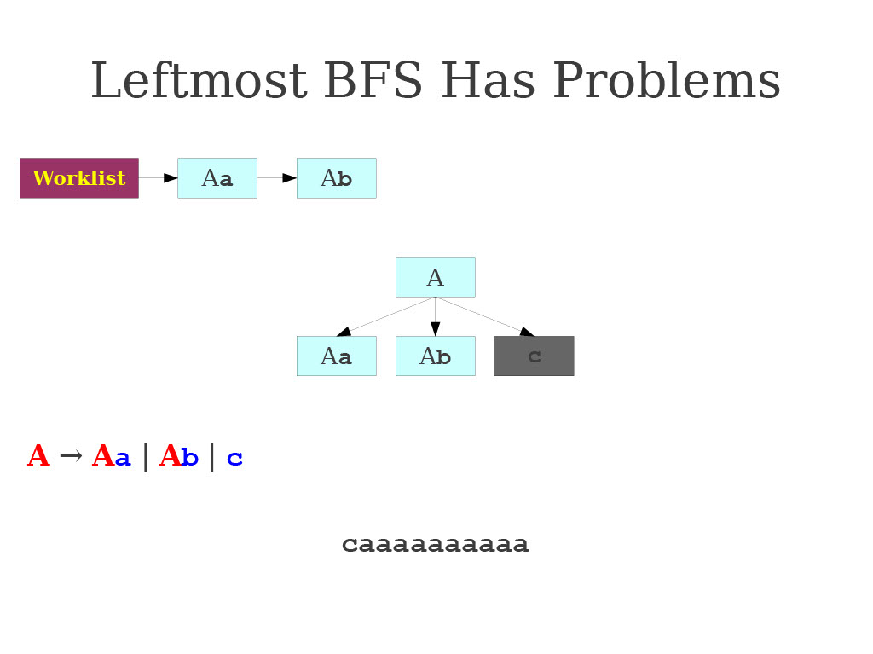
Practice 1: Leftmost BFS problem.

Slide 44
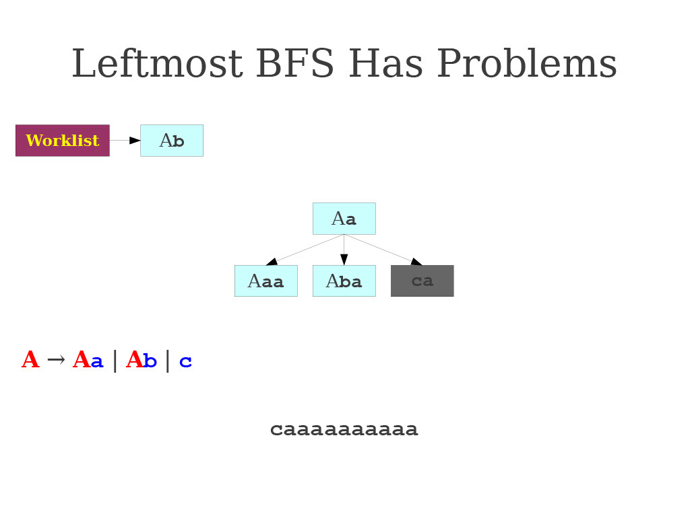
Practice 1: Leftmost BFS problem.

Slide 45
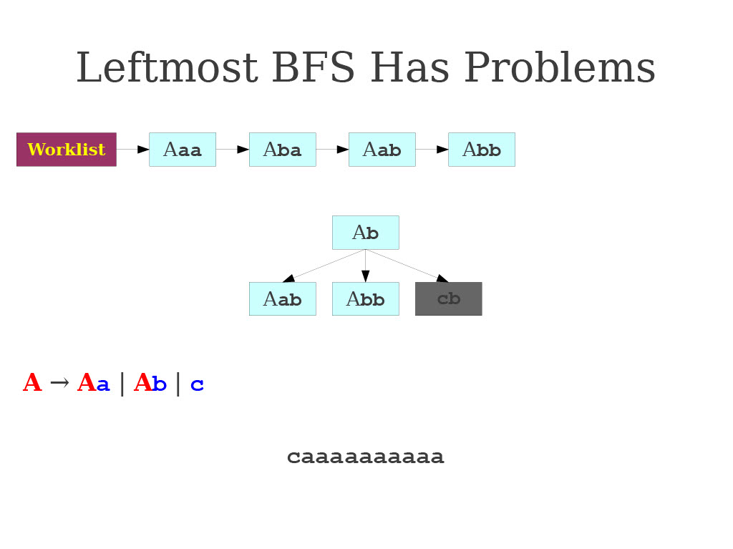
Practice 1: Leftmost BFS problem.

Slide 46
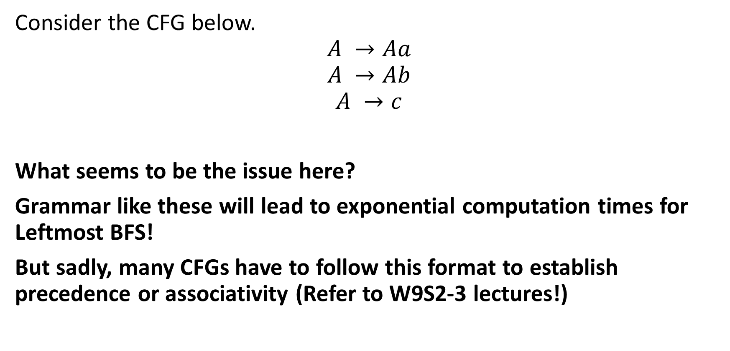
Practice 1: Leftmost BFS problem.
Consider the CFG below.
$$A →Aa$$
$$A →Ab$$
$$A →c$$
What seems to be the issue here?
Grammar like these will lead to exponential computation times for Leftmost BFS!
But sadly, many CFGs have to follow this format to establish precedence or associativity (Refer to W9S2-3 lectures!)

Slide 47
Using DFS instead of BFS?
Crazy idea: How about using DFS instead of BFS then?
Has a lower memory usage as it only considers one branch at a time.
On many grammars it will run very quickly
And it is fairly easy to implement as a set of mutually recursive functions.
Worth a try?

Slide 48
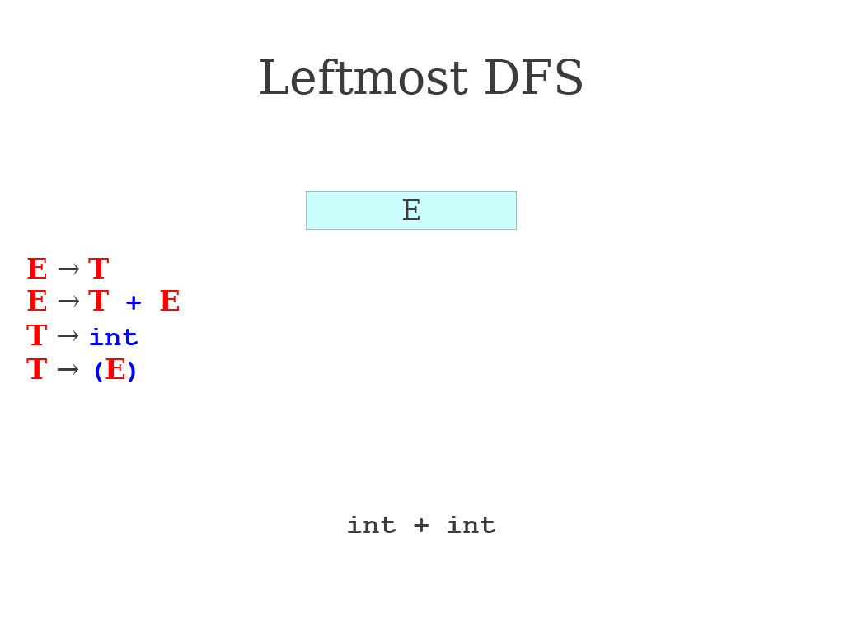
Leftmost DFS in action

Slide 49
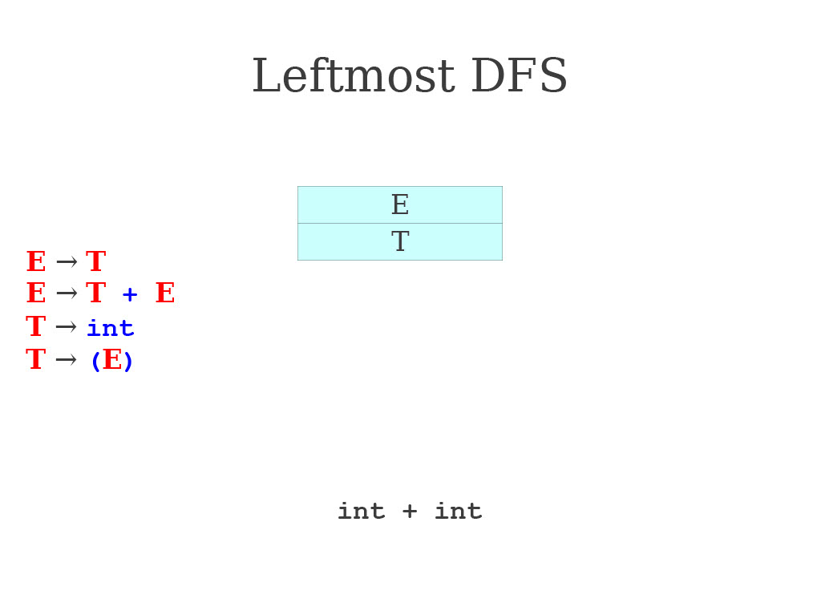
Leftmost DFS in action

Slide 50
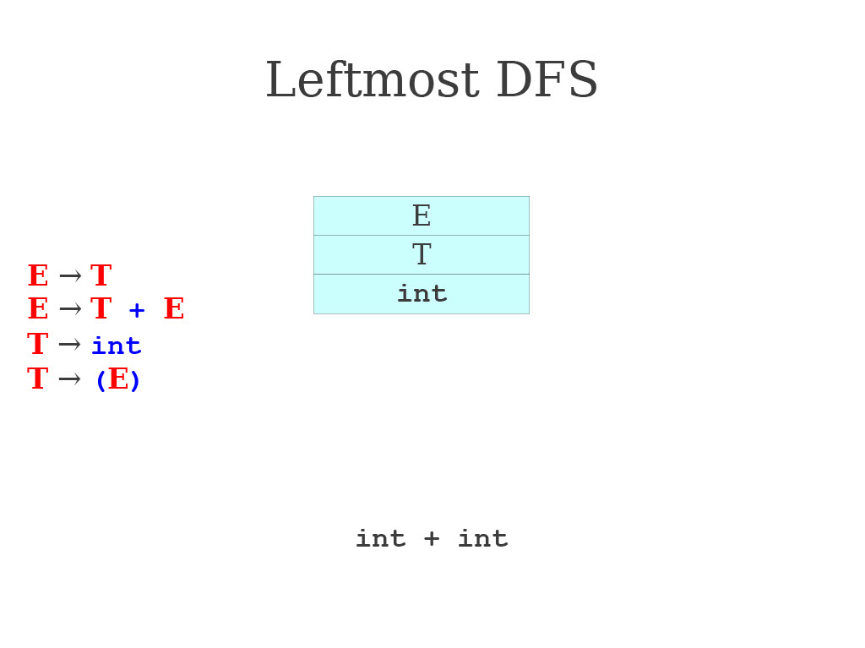
Leftmost DFS in action

Slide 51
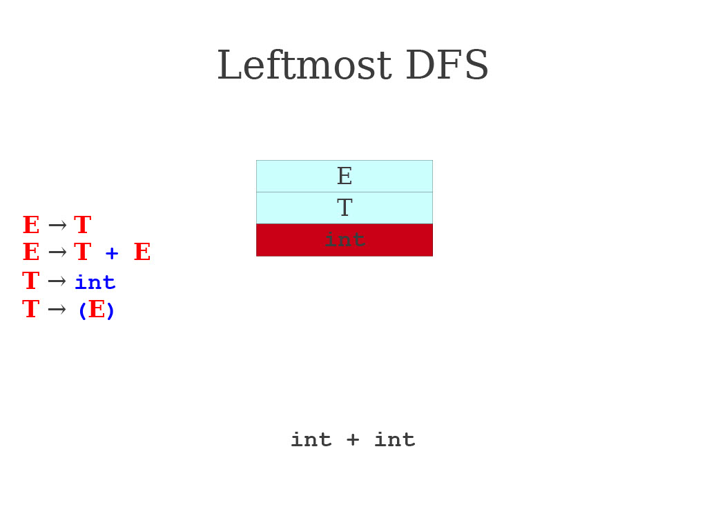
Leftmost DFS in action

Slide 52
Leftmost DFS in action

Slide 53

Leftmost DFS in action

Slide 54
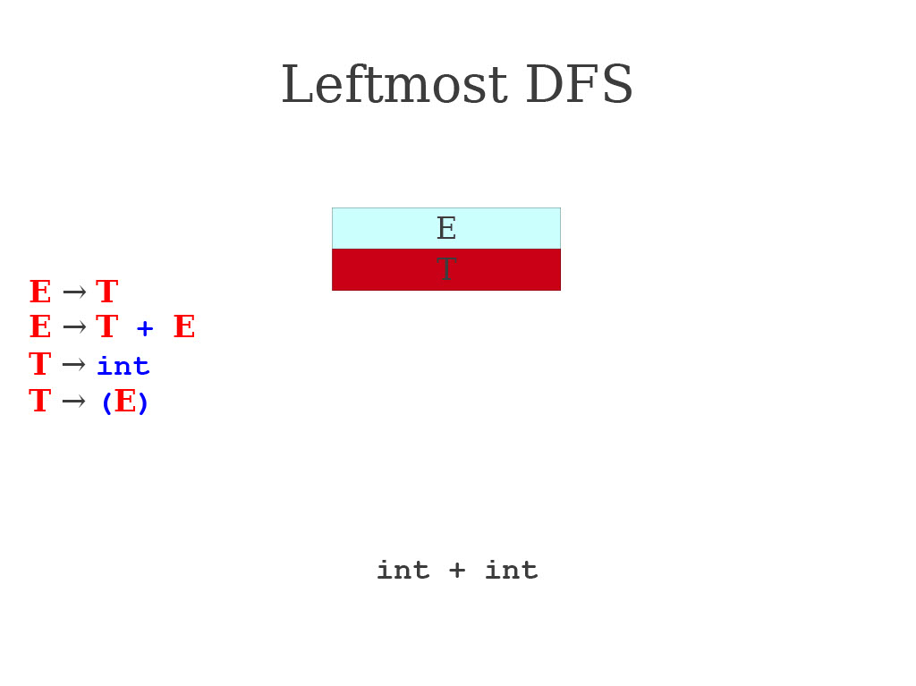
Leftmost DFS in action

Slide 55
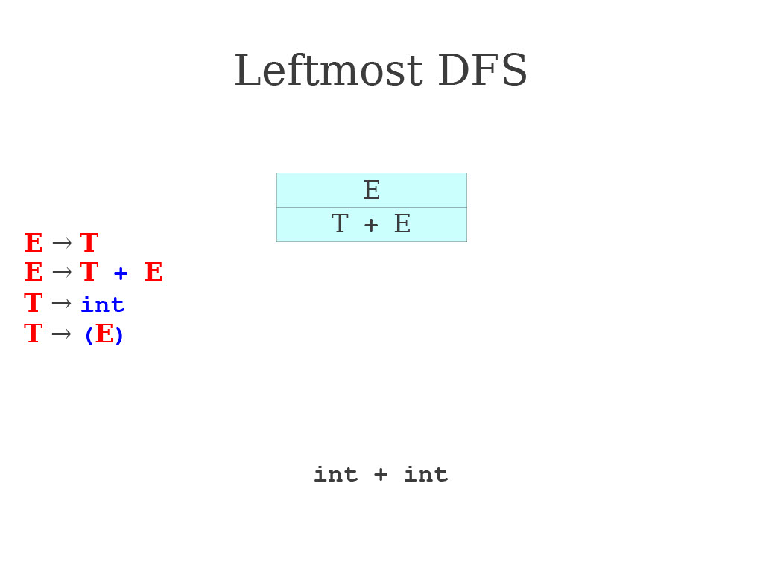
Leftmost DFS in action

Slide 56
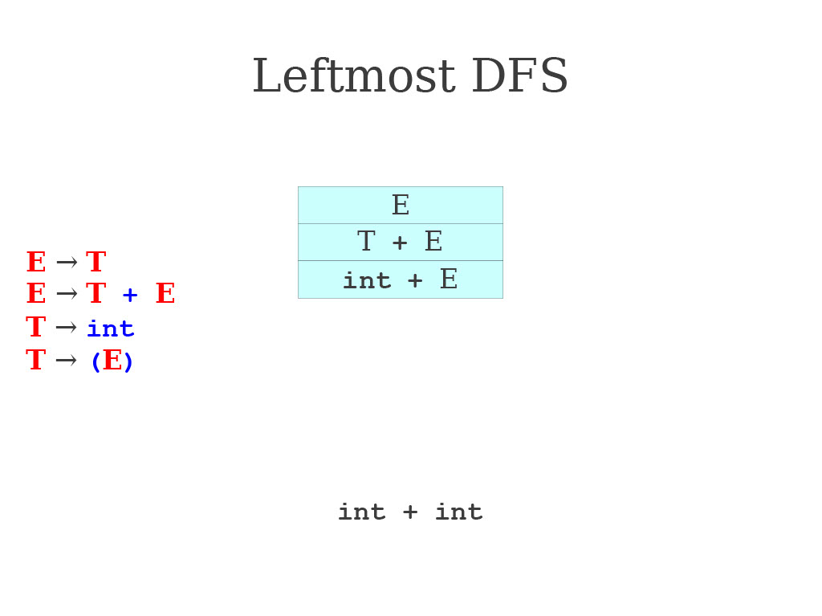
Leftmost DFS in action

Slide 57
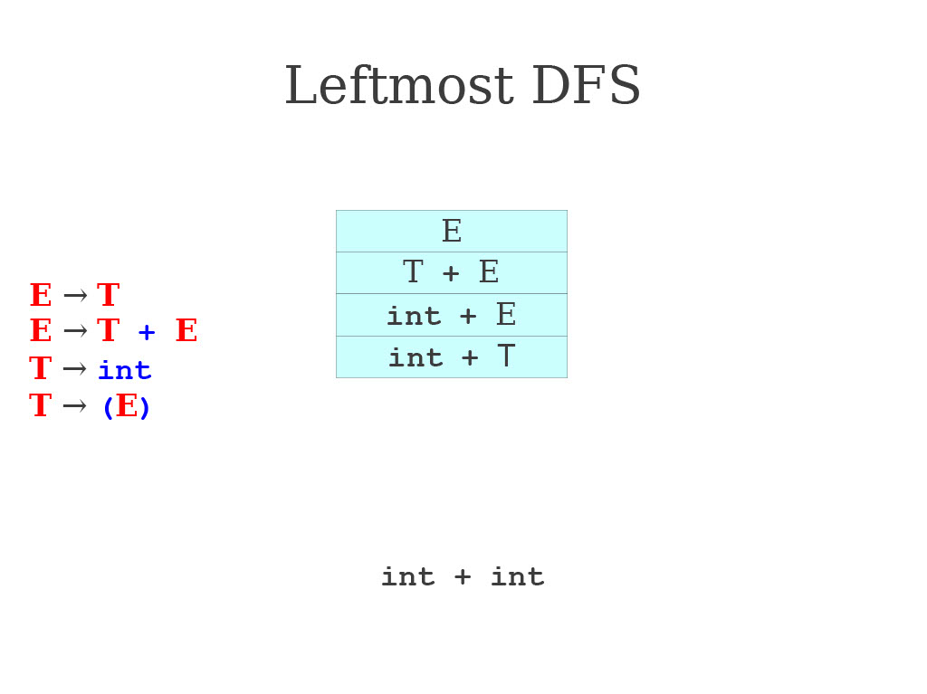
Leftmost DFS in action

Slide 58
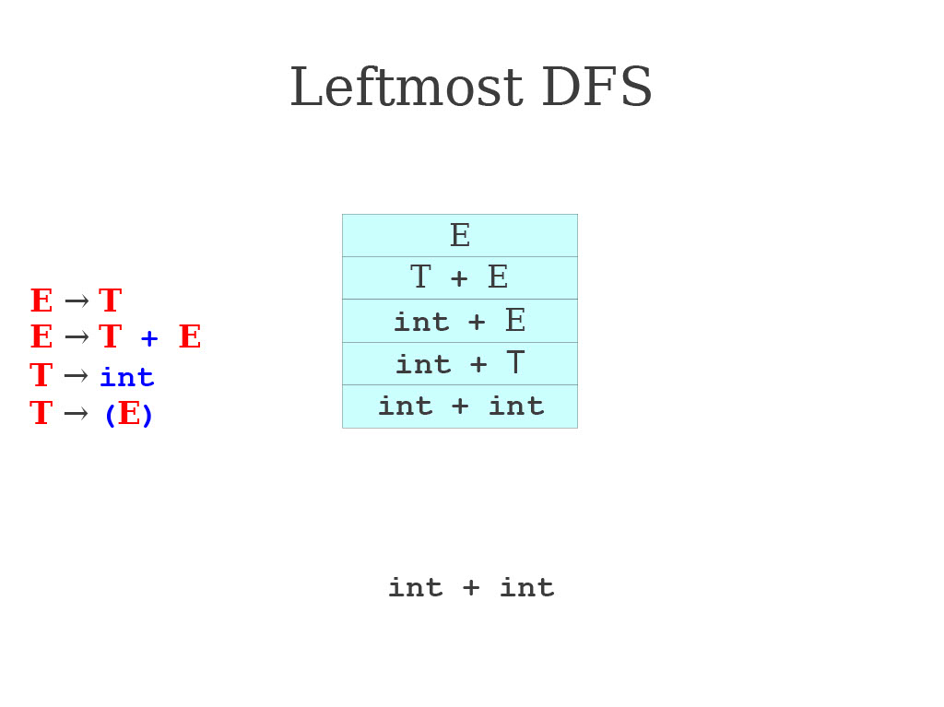
Leftmost DFS in action

Slide 59
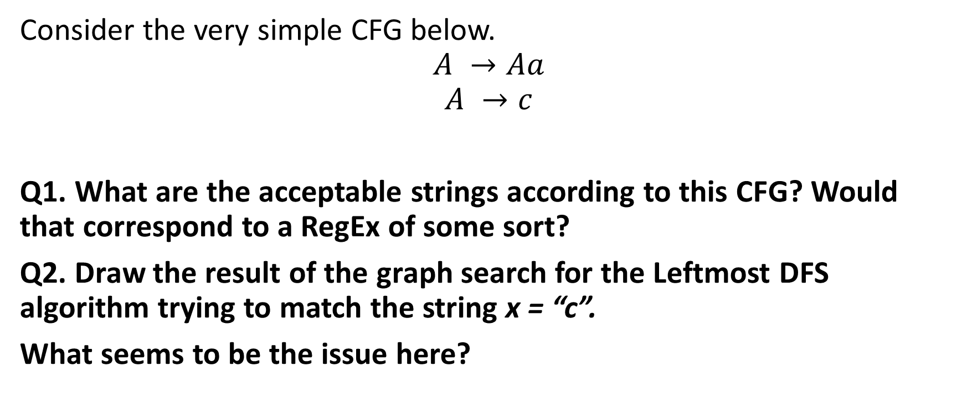
Practice 2: Leftmost DFS problem.
Consider the very simple CFG below.
$$A →Aa$$
$$A →c$$
Q1. What are the acceptable strings according to this CFG? Would that correspond to a RegEx of some sort?
Q2. Draw the result of the graph search for the Leftmost DFS algorithm trying to match the string x = “c”.
What seems to be the issue here?

Slide 60
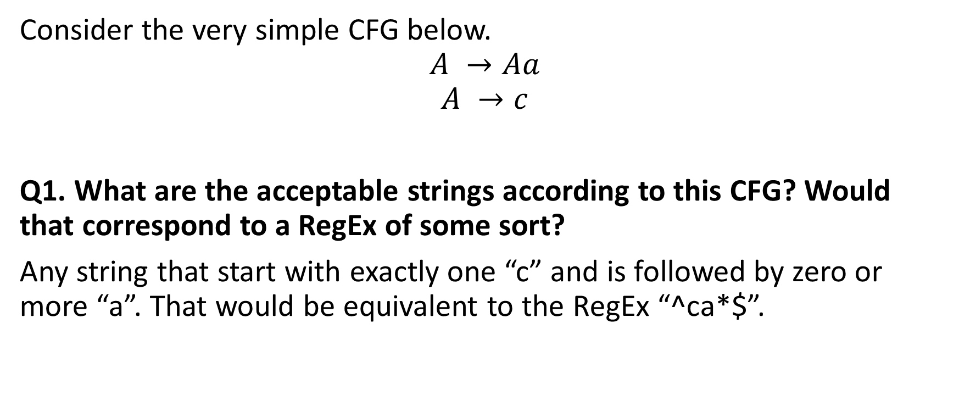
Practice 2: Leftmost DFS problem.
Consider the very simple CFG below.
$$A →Aa$$
$$A →c$$
Q1. What are the acceptable strings according to this CFG? Would that correspond to a RegEx of some sort?
Any string that start with exactly one “c” and is followed by zero or more “a”. That would be equivalent to the RegEx “^ca*$”.

Slide 61
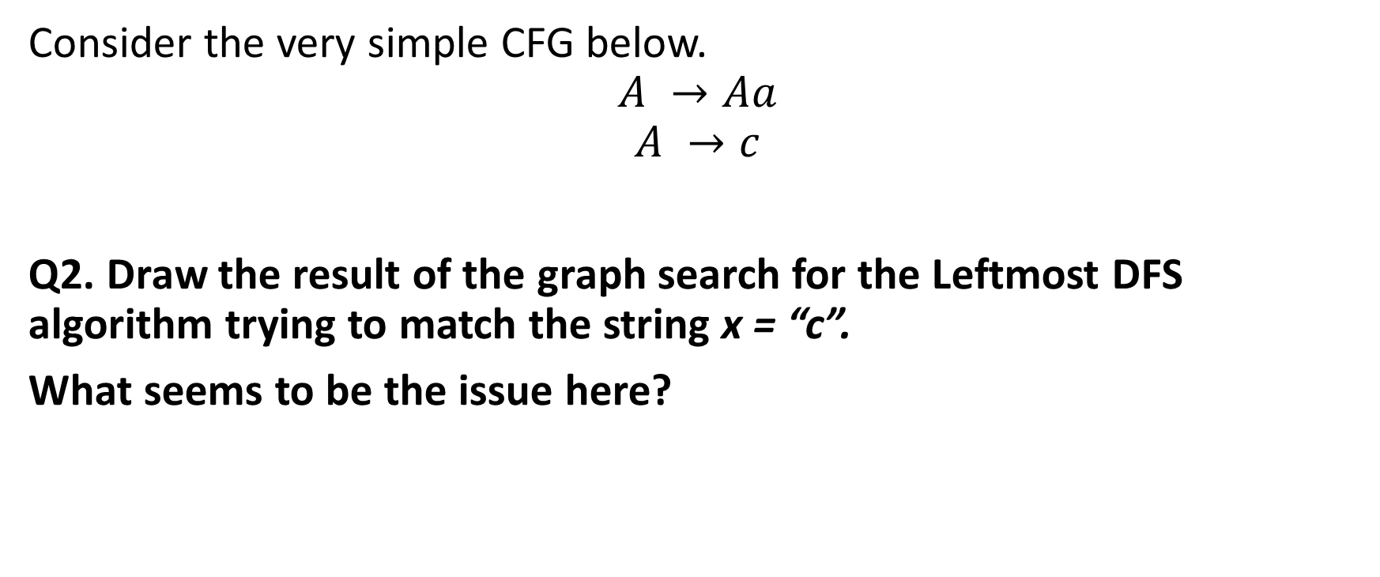
Practice 2: Leftmost DFS problem.
Consider the very simple CFG below.
$$A →Aa$$
$$A →c$$
Q2. Draw the result of the graph search for the Leftmost DFS algorithm trying to match the string x = “c”.
What seems to be the issue here?

Slide 62
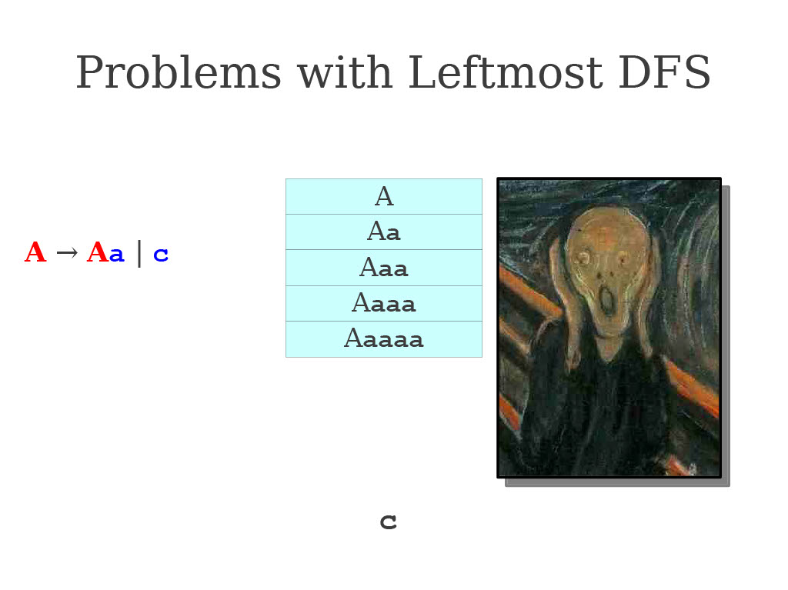

Aaaaaaaaaaaaaaaaaaaaaaaaaaaaaaaaaaaaaa
?

Slide 63
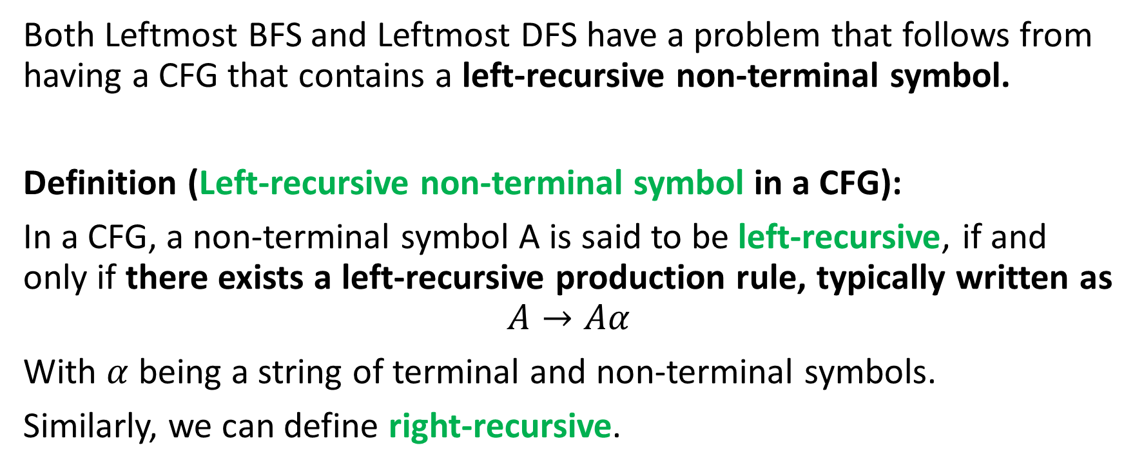
The problem with Leftmost BFS and DFS
Both Leftmost BFS and Leftmost DFS have a problem that follows from having a CFG that contains a left-recursive non-terminal symbol.
Definition (Left-recursive non-terminal symbol in a CFG):
In a CFG, a non-terminal symbol A is said to be left-recursive, if and only if there exists a left-recursive production rule, typically written as
$$A→Aα$$
With $α$ being a string of terminal and non-terminal symbols.
Similarly, we can define right-recursive.

Slide 64
The problem with Leftmost BFS and DFS
Both Leftmost BFS and Leftmost DFS have a problem that follows from having a CFG that contains a left-recursive non-terminal symbol.
Leftmost BFS: Takes exponential time and memory usage in presence of a left-recursive production rule.
Leftmost DFS: Fails, plain and simple.
Rightmost BFS and DFS will have the same problems in presence of a right-recursive production rule.
Serious issue: It might not always be easy or even possible to remove left- or right-recursive production rules from a given CFG, as it often serves for defining left- and right-associativity in certain operators!

Slide 65
The problem with Leftmost BFS and DFS
Both Leftmost BFS and Leftmost DFS have a problem that follows from having a CFG that contains a left-recursive non-terminal symbol.
Leftmost BFS: Takes exponential time and memory usage in presence of a left-recursive production rule.
Leftmost DFS: Fails, plain and simple.
Rightmost BFS and DFS will have the same problems in presence of a right-recursive production rule.
Conclusion: Using Leftmost/Rightmost BFS/DFS is not going to help with our parsing problem. Need more sophisticated algorithms.

Slide 66
Quiz time!
What is the difference between leftmost and rightmost derivations?
Leftmost derivations start with the rightmost non-terminal and work towards the leftmost non-terminal, while rightmost derivations do the opposite.
Leftmost derivations start with the leftmost non-terminal and work towards the rightmost non-terminal, while rightmost derivations do the opposite.
Leftmost derivations and rightmost derivations are the same thing, what matters is whether BFS or DFS is used only.
Leftmost derivations are used to describe languages that read from left to right (e.g. English), rightmost do the opposite (e.g. Arabic).

Slide 67
Quiz time!
What is the difference between leftmost and rightmost derivations?
Leftmost derivations start with the rightmost non-terminal and work towards the leftmost non-terminal, while rightmost derivations do the opposite.
Leftmost derivations start with the leftmost non-terminal and work towards the rightmost non-terminal, while rightmost derivations do the opposite.
Leftmost derivations and rightmost derivations are the same thing, what matters is whether BFS or DFS is used only.
Leftmost derivations are used to describe languages that read from left to right (e.g. English), rightmost do the opposite (e.g. Arabic).

Slide 68
Quiz time!
When parsing, which algorithm is the best?
BFS, always because it is guaranteed to converge.
DFS, because it is guaranteed to converge, it is also faster and more efficient than BFS.
When doing the graph search, we should in fact use DFS on some branches and BFS on some other branches of the graph.
Honestly, all these algorithms have problems.

Slide 69
Quiz time!
When parsing, which algorithm is the best?
BFS, always because it is guaranteed to converge. (Yes, but it has another problem, its heavy memory and computational cost)
DFS, because it is guaranteed to converge, it is also faster and more efficient than BFS (Incorrect, it will fail miserably with recursive grammars)
When doing the graph search, we should in fact use DFS on some branches and BFS on some other branches of the graph. (And how exactly do you plan to do that?)
Honestly, all these algorithms have problems.

Slide 70
Quiz time!
Which of the following is a left-recursive grammar?
S → aS | b
S → AB, A → aAa | a, B → bBb | b
S → Sb | a | b
S → Aa | bB, A → SA | a, B → SB | b, S → a | b

Slide 71
Quiz time!
Which of the following is a left-recursive grammar?
S → aS | b
S → AB, A → aAa | a, B → bBb | b
S → Sb | a | b
S → Aa | bB, A → SA | a, B → SB | b, S → a | b
(S could be seen as a recursive symbol but we need to use two production rules in a row, being S → Aa and A → SA?)

Slide 72
Predictive Parsing to the rescue?
The Leftmost/Rightmost BFS/DFS algorithms are backtracking algorithms.
Try productions and backtrack if they do not work.
Try to match prefix by sheer dumb luck, really.
Can we do better?
Yes! With another class of parsing algorithms called predictive parsers.
Core idea for predictive parsers: At any given time, use the remaining input to predict, without backtracking, which production rule should be used.

Slide 73
Predictive Parsing to the rescue?
Predictive parsers are fast.
Many predictive parsing algorithms can be made to run in linear time.
As will be seen later, can be table-driven for extra performance.
Predictive parsers are weak.
Not all grammars can be accepted by predictive parsers, and these grammars will have to be readjusted manually. (Remember, designing a good CFG is not algorithmically possible!)
Will often trade expressiveness for speed.

Slide 74
Predictive Parsing to the rescue?
Central question for predictive parsers: Given just the start symbol, how do you know which productions to use to get to the input string?
Idea: Use a lookahead predictive procedure.
When trying to decide which production rule to use to replace the leftmost non-terminal symbol, look at the next k symbols of the input to help make the decision of which production rules to use or eliminate.
Corollary: Predictive parsing is only possible if the CFG allows to predict which production to use given some lookahead symbols. (This might not be possible with all CFGs!)

Slide 75
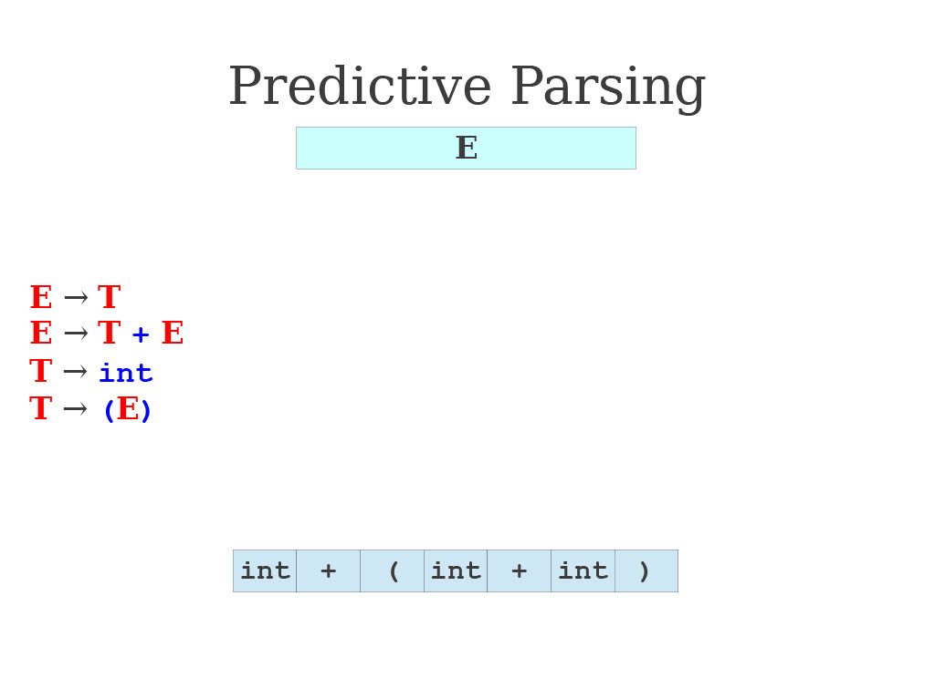
An illustrated Predictive Parser at play

Slide 76

An illustrated Predictive Parser at play

Slide 77

An illustrated Predictive Parser at play

Slide 78

An illustrated Predictive Parser at play

Slide 79

An illustrated Predictive Parser at play

Slide 80

An illustrated Predictive Parser at play

Slide 81

An illustrated Predictive Parser at play

Slide 82

An illustrated Predictive Parser at play

Slide 83

An illustrated Predictive Parser at play

Slide 84

An illustrated Predictive Parser at play

Slide 85
Naming convention for predictive parsers
Top-down predictive parsing has a naming convention:
First letter: L, if Left-to-right scan of the symbols (R, if right-to-left).
Second letter: L, if Leftmost derivation (R, if rightmost instead).
Number: (1), if one symbol of lookahead (could be another number k).
LL(1): Construct a leftmost derivation (.L), scanning symbols from left to right (L.), for the sequence of symbols.
When replacing a non-terminal, we predict the production rule to use by looking at the next symbol (1) of the input.
The decision on which production rule to use is then forced.
Our previous demo was technically LL(2), two yellow blocks needed.

Slide 86

LL(1) will often define some parse tables
How to read the LL(1) table.
Line = Which non-terminal symbol is about to be replaced.
Column = What is the next terminal symbol in x that must match this non-terminal.
In the cell = What to replace the non-terminal symbol (line) with.

Slide 87

LL(1) at work!
Notes
The Table on the left now contains the index of the production rule to use to make the replacement (equivalent to previous table)
Additional symbol: using the $ symbol to indicate the end of the two strings (current string being parsed and target string to match).

Slide 88

LL(1) at work!

Slide 89

LL(1) at work!

Slide 90

LL(1) at work!

Slide 91

LL(1) at work!

Slide 92

LL(1) at work!

Slide 93

LL(1) at work!

Slide 94

LL(1) at work!

Slide 95

LL(1) at work!

Slide 96
LL(1) will often define some parse tables
How to read the LL(1) table.
Line = Which non-terminal symbol is about to be replaced
Column = What is the next terminal symbol in x that must match this non-terminal
In the cell = What to replace the non-terminal symbol (line) with.
Empty cell? = Invalid syntax

Slide 97

Detecting syntax errors with LL(1): mismatch
Here “int + int” is invalid according to our CFG (it says we should use parentheses with addition, always).
The parsed string produced by LL(1) eventually runs out of non-terminal symbols before the input string x does.
That is a mismatch (syntax) error.

Slide 98

Detecting syntax errors with LL(1): no prediction
Here “(int (int))” is invalid according to our CFG (can only use parentheses with plus symbols, not without).
The LL(1) eventually refers to an empty cell in the table, which indicates that there is no way to parse the string further. Syntax error!

Slide 99

The LL(1) algorithm, detailed
Suppose our CFG has start symbol S and we have manually defined a LL(1) parsing table T.
We want to parse string $ω$.
The LL(1) algorithm steps are as follows
Initialize a stack #1 with “S$”
Initialize a stack #2 containing the characters in the string $ω$, terminate with $.
Repeat 4, 5, 6 (next slide) until one of the stacks becomes empty (only $ left). If both are empty at the same time, success!

Slide 100
The LL(1) algorithm, detailed
Draw character t from the top of stack #2.
If the top of the stack #1 is a terminal symbol r:
If r and t do not match, report a syntax error, end the derivation.
Otherwise remove the character t and pop r from the stack.
Otherwise, the top of the stack #1 is a non-terminal symbol A:
If T[A, t] is empty, no prediction can be made, report a syntax error, end the derivation.
Otherwise, simply replace the symbol A at the top of the stack #1 with the production that is in T[A, t].

Slide 101
Building a LL(1) parsing table
Question: How can we build a LL(1) parsing table for a given CFG?
What we want: The next character should uniquely identify a production rule to use, so we should pick a production that ultimately starts with that character.

Slide 102

Building a LL(1) parsing table
Property: Deciding for the appropriate production to use in $T[A, t]$.
$T[A, t]$should suggest to use a production rule $A→ω$iff. $ω$ can later be used to derive something starting with $t$.
Mathematically, this writes as:
$T\left[A, t\right]=ω$ iff. $A→ω$exists and $ω$ ⇒* $tω′$
Could be figured out manually (tedious).

Slide 103

Definition: FIRST Sets F
Definition (FIRST Set $F$ for a given non-terminal symbol):
The FIRST Set of a non-terminal symbol $A$, denoted $F(A)$ in a context-free grammar is the set of terminal symbols that can appear as the first symbol in any string derived from that non-terminal.
In other words, the FIRST set of a non-terminal represents all possible prefix terminal symbols that can be generated by applying the production rules of the grammar, starting from that non-terminal.
Mathematically: $F\left(A\right)=\left\{t \right| A \text{⇒∗} tω for some ω\}$
Property #1: if $A$ is a terminal symbol, then, $F(A) = \{A\}$.
Property #2: if $A$ → $Bω$ and $B$ → $c$, then $c∈ F(A)$.

Slide 104

Computing a FIRST Sets F
Consider the CFG below.
S → AB
A → a | c
B → b
In our CFG above, S, A, and B are non-terminal symbols, and a, b and c are terminal symbols.
What is F(A) here?
$$F\left(A\right)=\{a, c\}$$
What is F(B) here?
$$F\left(B\right)=\{b\}$$
What is F(S) here?
According to Property #2, that would be the same as $F(A)$.
$$F\left(S\right)=\{a, c\}$$

Slide 105


Practice 3: computing FIRST sets for a CFG
Consider the second CFG below.
S → ACB
A → a | B | $ε$
B → b
C → c | d
Note: here $ε$ denotes the empty string, meaning that A could be replaced with nothing.
In general, using $ε$ in a CFG makes things much more difficult.
Question: Looking at the CFG on the left, what are $F(A)$and $F(S)$?

Slide 106

Practice 3: computing FIRST sets for a CFG
Consider the second CFG below.
S → ACB
A → a | B | $ε$
B → b
C → c | d
Note: here $ε$ denotes the empty string, meaning that A could be replaced with nothing.
In general, using $ε$ in a CFG makes things much more difficult.
Question: Looking at the CFG on the left, what are $F(A)$and $F(S)$?
Answer: The $ε$makes it trickier.
We have
$$F\left(A\right)=\left\{a, ε\right\} ∪F\left(B\right)=\{a,b,ε\}$$
The FIRST set for $S$ is a bit awkward to build, but could we do…
$$F\left(S\right)=F\left(A\right)∪F\left(B\right)∪F\left(C\right)−\{ε\}$$
$$=\left\{a,b,c,d\right\}?$$
But is this $=$correct mathematically speaking? (Unproven at the moment)

Slide 107

Building a LL(1) table using FIRST sets.
The following algorithm constructs an LL(1) parse table for a CFG with no $ε$-productions.
Compute the FIRST sets for all non-terminal symbols in the grammar.
For each production $A → tω$, set $T[A, t] = tω$.
For each production $A → Bω$, set $T[A, t] = Bω$, for each $t ∈ F(B)$.
When $ε$-productions are present, it might get trickier... (As hinted and discussed in Practice 3)

Slide 108
Building a LL(1) table using FIRST sets.
To demonstrate how it is done, let us consider the CFG below.
S → AB
A → aX
B → bY
X → x
Y → y
Step 1: Initialize an empty table with rows for each non-terminal (S, A, B, X, and Y) and columns for each terminal (a, b, x, y) and the end-of-input marker ($).
(Shown later…)

Slide 109

Building a LL(1) table using FIRST sets.
To demonstrate how it is done, let us consider the CFG below.
S → AB
A → aX
B → bY
X → x
Y → y
Step 2: For each non-terminal, compute the first sets:
$F(Y) = \{y\}$
$F(X) = \{x\}$
$F\left(A\right)= \left\{a\right\}$
$F\left(B\right)= \left\{b\right\}$
$F\left(S\right)=F\left(A\right)=\{a\}$

Slide 110
Building a LL(1) table using FIRST sets.
To demonstrate how it is done, let us consider the CFG below.
S → AB
A → aX
B → bY
X → x
Y → y
Step 3: Use each first set to populate the table.
Ready to use LL(1) now!
 | a | b | x | y
S | AB
A | aX
B |  | bY
X |  |  | x
Y |  |  |  | y

Slide 111
Practice 4: LL(1) table with weird CFGs
Consider the second CFG below.
S → Aa | Ab
A → x | y
Question: Can you build the LL(1) parsing table for this CFG?
What appears in the T[S,x] cell?
Would that be acceptable for the LL(1) parser?

Slide 112
Practice 4: LL(1) table with weird CFGs
Consider the second CFG below.
S → Aa | Ab
A → x | y
Question: Can you build the LL(1) parsing table for this CFG?
What appears in the T[S,x] cell?
Would that be acceptable for the LL(1) parser?
Answer: In this CFG, we have the following LL(1) parsing table.
The table does not tell us much!
 | x | y
S | Aa Ab | Aa Ab
A | x | y

Slide 113
FIRST-FIRST conflicts
In general, we do not like having a CFG that produces multiple entries in a given LL(1) parsing table, as it would mean branches in the graph search…
This is commonly referred to as a FIRST-FIRST conflict, as many possible rules could be used for a given non-terminal and terminal pair.
This unfortunately leads to the LL(1) parser having to explore multiple branches and not being able to prune as much.
 | x | y
S | Aa Ab | Aa Ab
A | x y | x y

Slide 114

FIRST-FIRST conflicts
This might become especially true in the cases of CFGs with $ε$-productions.
When a production appears, a non-terminal symbol might disappear and let another non-terminal symbol appear in its place, as was the case in Practice 3. This is called a FIRST-FIRST conflict.

Slide 115

Practice 3: computing FIRST sets for a CFG
Consider the second CFG below.
S → ACB
A → a | B | $ε$
B → b
C → c | d
Note: here $ε$ denotes the empty string, meaning that A could be replaced with nothing.
In general, using $ε$ in a CFG makes things much more difficult.
Question: Looking at the CFG on the left, what are $F(A)$and $F(S)$?
Answer: The $ε$makes it trickier.
We have
$$F\left(A\right)=\left\{a, ε\right\} ∪F\left(B\right)=\{a,b,ε\}$$
The FIRST set for $S$ is a bit awkward to build, but could we do…
$$F\left(S\right)=F\left(a\right)∪F(B)∪F\left(C\right)$$
$$=\left\{a,b,c,d\right\}?$$
But is this $=$correct mathematically speaking? (Unproven at the moment)

Slide 116

Main takeaway from Practice 3
The FIRST set for $S$ is a bit awkward to build, but could we do…
$$F\left(S\right)=F\left(a\right)∪F(B)∪F\left(C\right)$$
$$=\left\{a,b,c,d\right\}?$$
But is this $=$correct mathematically speaking? (Unproven at the moment)
Need a formalism to cover for $ε$-productions!

Slide 117

Definition: FIRST Sets F
Definition (FIRST Set $F$ for a given non-terminal symbol):
The FIRST Set of a non-terminal symbol $A$, denoted $F(A)$ in a context-free grammar is the set of terminal symbols that can appear as the first symbol in any string derived from that non-terminal.
In other words, the FIRST set of a non-terminal represents all possible first terminal symbols that can be generated by applying the production rules of the grammar, starting from that non-terminal.
Mathematically: $F\left(A\right)=\left\{t \right| A \text{⇒∗} tω for some ω\}$
Property #1: if $A$ is a terminal symbol, then, $F(A) = \{A\}$.
Property #2: if $A$ → $Bω$ and $B$ → $c$, then $c∈ F(A)$.

Slide 118

Definition: FIRST* Sets F
Definition (FIRST* Set $F^{∗}$ for a given non-terminal symbol):
We can generalize FIRST sets to any string with FIRST* sets.
We simply have $F^{∗}(ω)$ being the set of all terminals (or $ε$) that can appear at the start of a string derived from $ω$.
Property #1: If $S →ABω$, and $A$ has a production rule that contains $ε$, but not $B$, then $F^{∗}(S) = F(A) ∪ F(B) − \{ε\}$.
Property #2: We can build $F\left(A\right)$ incrementally, by repeating the following operation, for each production $A →α$.
$$F\left(A\right)=F\left(A\right) ∪F^{∗}(α)$$

Slide 119


Definition: FIRST* Sets F
Going back to our previous CFG
S → ACB
A → a | B | $ε$
B → b
C → c | d
We can now correctly establish what $F(A)$is using .
Using our $F^{∗}$ notation and the previous properties, we can now rigorously prove that:
F(A) = F(A) ∪ F(B) ∪ F(ε) = {a, b, ε}
F(C) = {c, d}
F(S) = $F^{∗}$(ACB)
= F(A) ∪ F(C) - {ε}
= {a, b, c, d}

Slide 120


Definition: FOLLOW Sets $N$
Definition (FOLLOW Set $N$ for a given non-terminal symbol):
The FOLLOW Set of a non-terminal symbol 𝑨, denoted $N(A)$ in a context-free grammar, is the set of terminal symbols that can appear immediately after that non-terminal symbol in any sentential form derived from the grammar's start symbol.
In other words, the FOLLOW set of a non-terminal represents all possible terminal symbols that can be generated by applying the production rules of the grammar and appear right after that non-terminal in any derivation.
Mathematically: $N(A)=\{t | S ⇒∗ ωAtω′ for some ω, ω′\}$

Slide 121

Properties of the FOLLOW sets
You can compute the FOLLOW sets for a given CFGs, iteratively, as follows.
If 𝐴 is the start symbol, then the end-of-input marker ($) is in $N(A)$.
If$B→αAω$is a production rule, then you can set $N\left(A\right)= N\left(A\right)∪F^{∗}\left(ω\right)−\{ε\}$
If$B→αAω$is a production rule and ${ε∈F}^{∗}\left(ω\right)$, then you can set $N\left(A\right)= N\left(A\right)∪N\left(B\right)$

Slide 122

Final LL(1) parsing table algorithm
Step 1: Given a CFG, compute the FIRST and FOLLOW sets, F(A) and N(A), for every non-terminal symbol A.
Step 2: For each rule $A→ω$, and for each terminal symbol in F$(ω)$, set $T\left[A,t\right]=ω$. Keep in mind that, by convention, $ε$ is technically not a terminal symbol!
Step 3: For each rule $A→ω$, if $ε∈F^{∗}(ω)$, set $T\left[A,t\right]=ω$ for each $t∈N(A)$.
Note: Technically, and even though the notation is somewhat bad, we can describe the set procedure in 2-3 as equivalent to
For each rule $A→ω$, and for each terminal symbol in $F^{∗}(ωN(A))$, set $T\left[A,t\right]=ω$. (Keep in mind that $ε$ is not a terminal symbol).

Slide 123


Building an LL(1) table with epsilon prod.
Notes
When the CFG contains $ε$-production rules, you should add the string termination symbol $ in the LL(1) table and treat it as a terminal symbol.

Slide 124
Building an LL(1) table with epsilon prod.
Step 1: Compute the FIRST and FOLLOW sets for all non-terminal symbols in our CFG.
(In the interest of time, showing results only, up to you to try it again at home for practice! Solution in backup slides!)

Slide 125

Building an LL(1) table with epsilon prod.

Slide 126
Building an LL(1) table with epsilon prod.
Next, repeat Steps 2 and 3, as mentioned earlier to fill the LL(1) parsing table!

Slide 127

Building an LL(1) table with epsilon prod.

Slide 128

Building an LL(1) table with epsilon prod.

Slide 129

Building an LL(1) table with epsilon prod.

Slide 130

Building an LL(1) table with epsilon prod.

Slide 131

Building an LL(1) table with epsilon prod.

Slide 132

Building an LL(1) table with epsilon prod.

Slide 133

Building an LL(1) table with epsilon prod.

Slide 134

Building an LL(1) table with epsilon prod.

Slide 135

Building an LL(1) table with epsilon prod.

Slide 136
LL(1) is cumbersome but seems to work!
Does LL(1) work well on all CFGs?
No, not guaranteed.
In general, any CFG with a left recursion will lead to having multiple productions rules in a given entry of the LL(1) table.
This could lead to FIRST-FIRST conflicts. If it does, we simply say, in that case that the CFG is not LL(1).
While it might be possible sometimes to rewrite a non-LL(1) CFG into an equivalent LL(1) CFG, there is technically no clear method on how to do so 100% of the time.
And most grammars cannot be represented as LL(1) anyway…! (The CFG for C is not LL(1) unfortunately!)

Slide 137
Predictive Parsing to the rescue?
Quick Question: How many symbols k should we look ahead then?
There is a trade-off on the number of symbols k we should use.
Increasing the number of lookahead tokens increases the number of grammars we can parse, but complicates the parser. A grammar might not be LL(1), but it could be LL(k), with k>1!
A smaller number of lookahead tokens simplifies the parser, but forces grammars and syntax being expressed to be simpler as well.
LL(k) algorithms are more robust but not immune to problems either.
The method and implementation of LL(k) parsing algorithms is definitely out-of-scope for this class.

Slide 138
Summary and conclusion
Top-Down parsing: Try to derive the user program from the start symbol of the programming language CFG.
Leftmost BFS and DFS: Uncommon in practice and fail for very simple recursive CFGs.
Predictive LL(1) parsers: scans from left to right, lookahead of one symbol to try and find the next leftmost derivation to use. Faster than basic BFS and DFS. Not immune to problems when CFG is not LL(1).
Predictive LL(k) parsers: same as LL(1) but k symbols of lookahead. Covers more possible grammars, but computationally more expensive and still not immune to problems.
→ Difficult and somewhat impossible task so far! More importantly the CFG for the C language is not LL(k)… Will need other approaches (to be discussed next lecture).

Slide 139

FIRST sets for our Epsilon CFG in LL(1) demo

Slide 140

FIRST sets for our Epsilon CFG in LL(1) demo
Terminal symbols have themselves as FIRST sets

Slide 141

FIRST sets for our Epsilon CFG in LL(1) demo
FIRST(Num) receives the values of FIRST(Sign), but not epsilon.

Slide 142

FIRST sets for our Epsilon CFG in LL(1) demo
Same with FIRST(Digits) and FIRST(Digit)

Slide 143

FIRST sets for our Epsilon CFG in LL(1) demo
Same with FIRST(More) and FIRST(Digits)

Slide 144

FIRST sets for our Epsilon CFG in LL(1) demo
Epsilon appears in FIRST(Sign) and FIRST(More)

Slide 145

FIRST sets for our Epsilon CFG in LL(1) demo
Since Epsilon appears in FIRST(Sign), FIRST(Num) should receive the terminals in FIRST(Digits)

